Slide 1
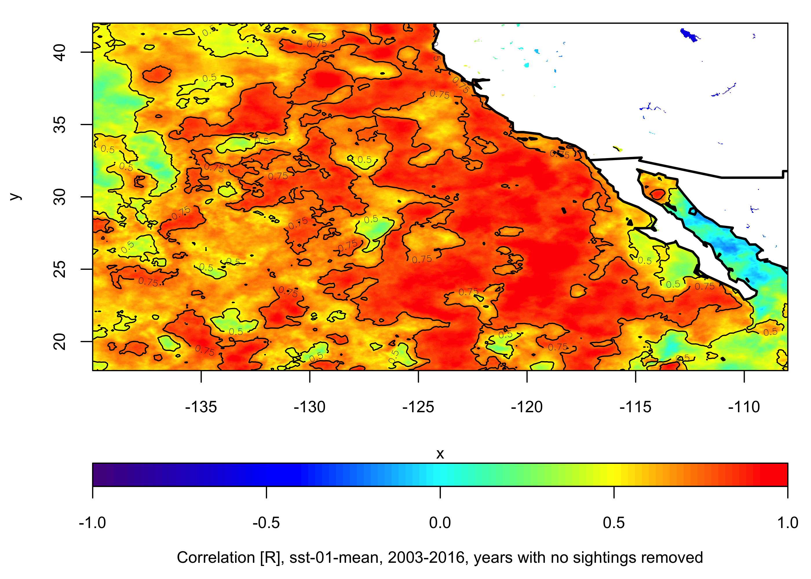
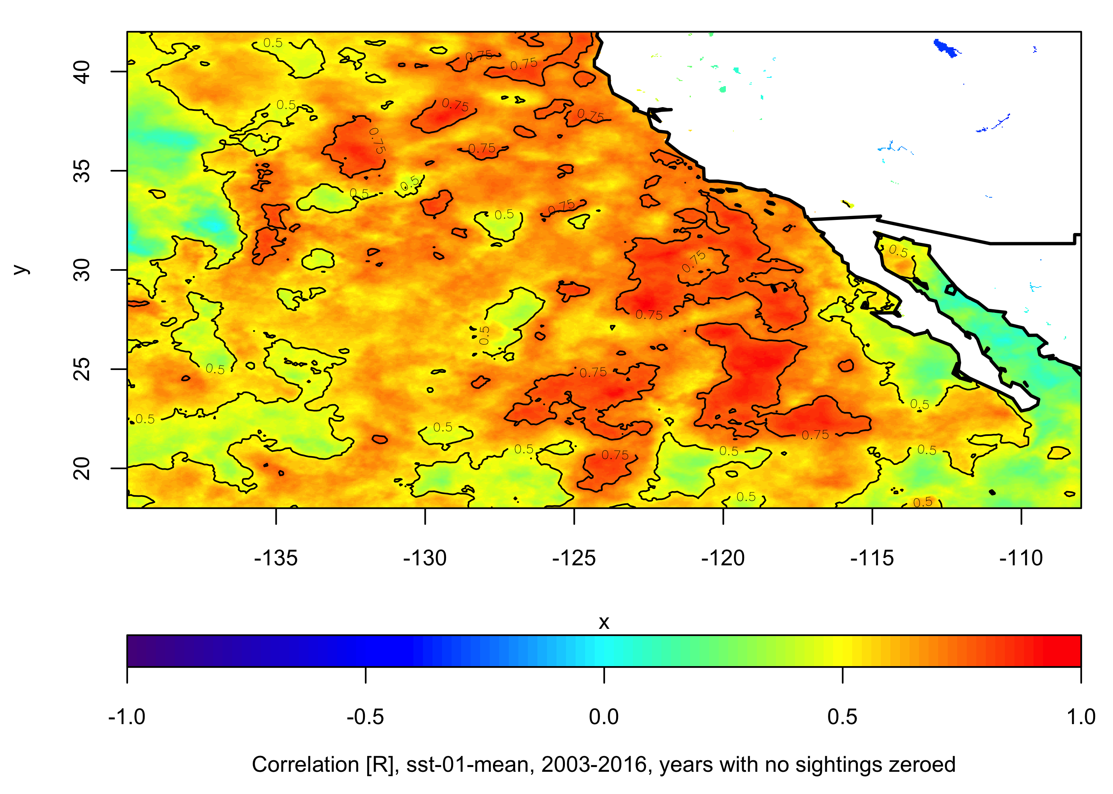
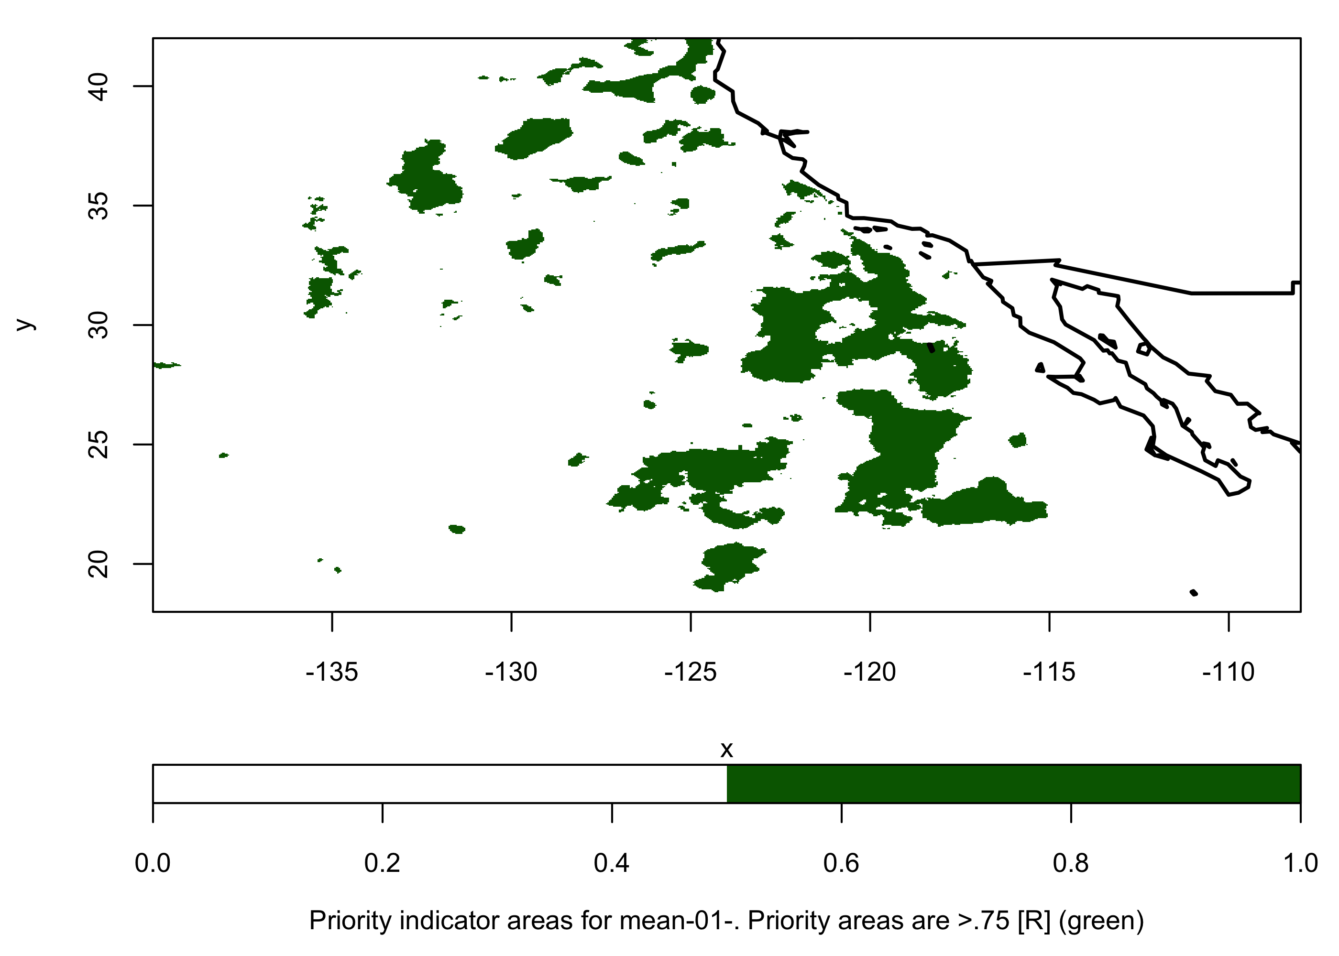
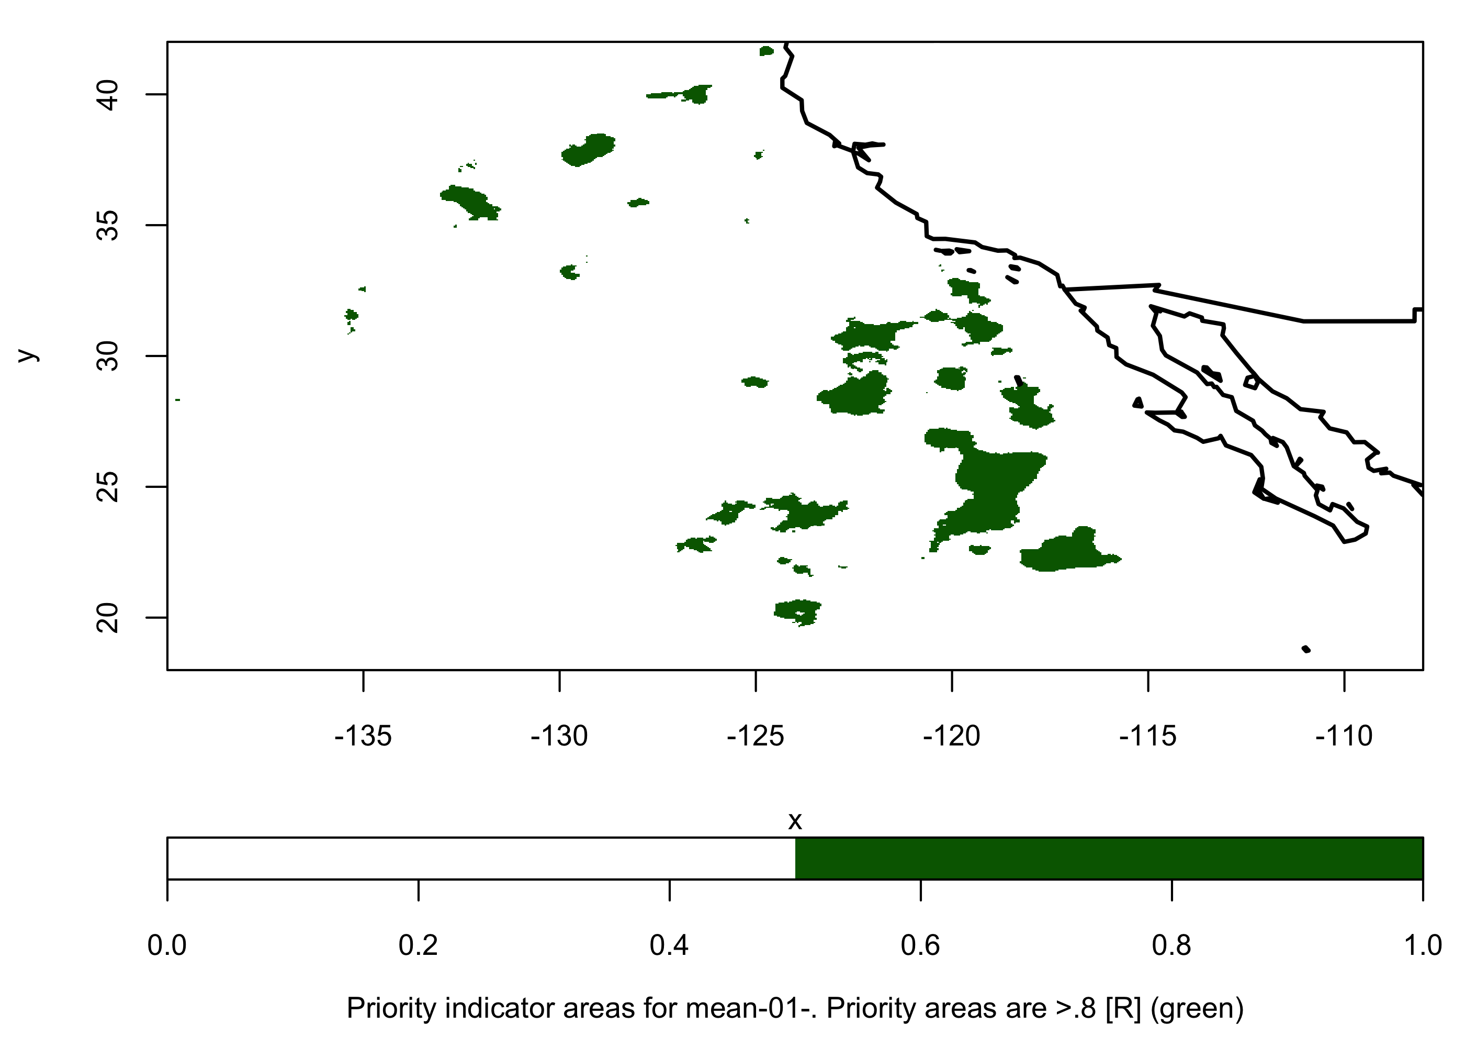
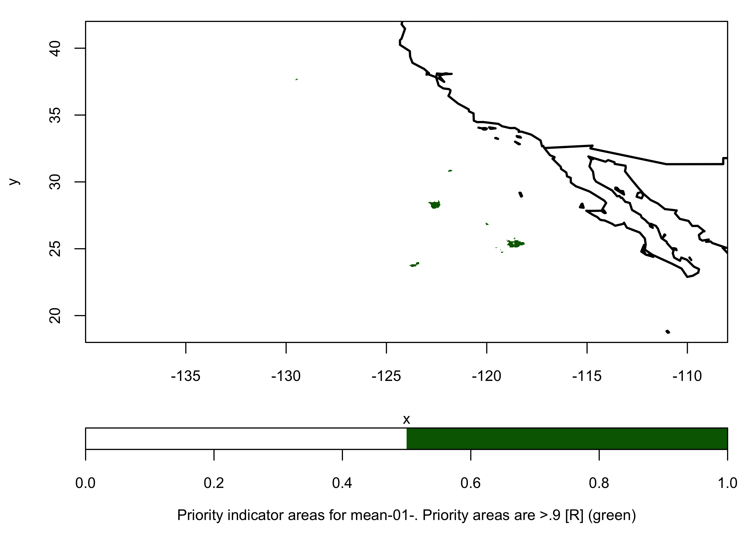
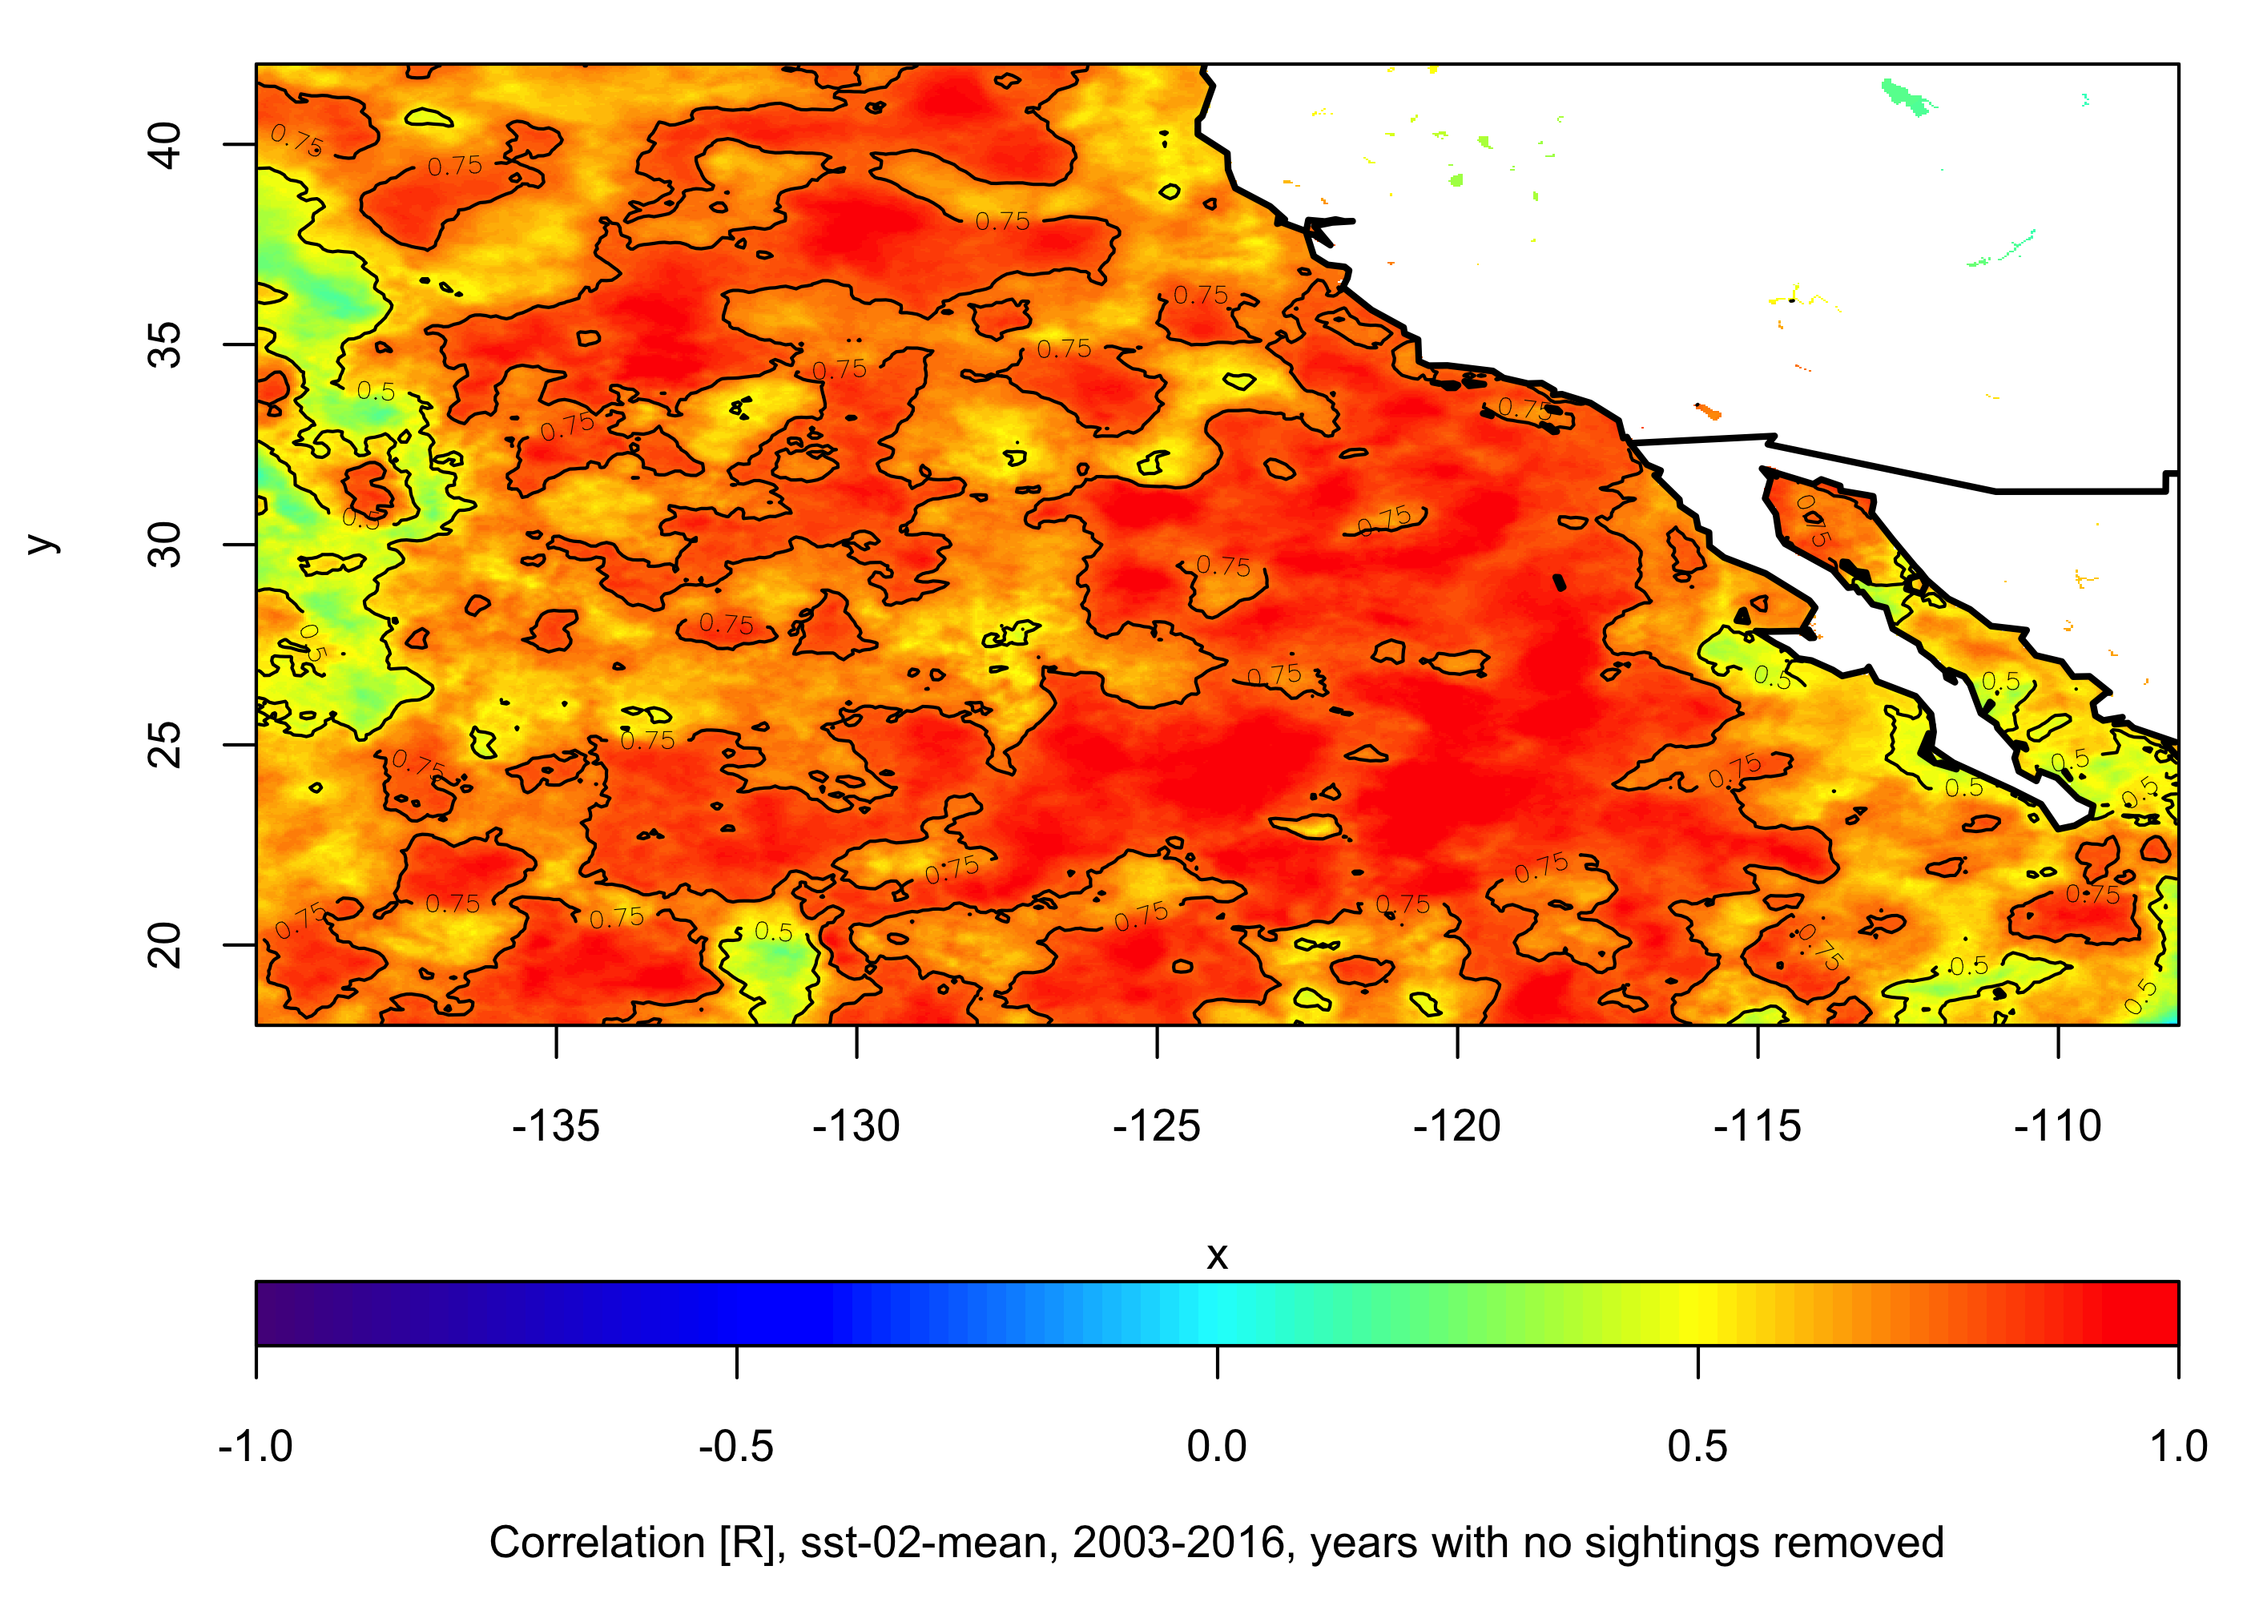
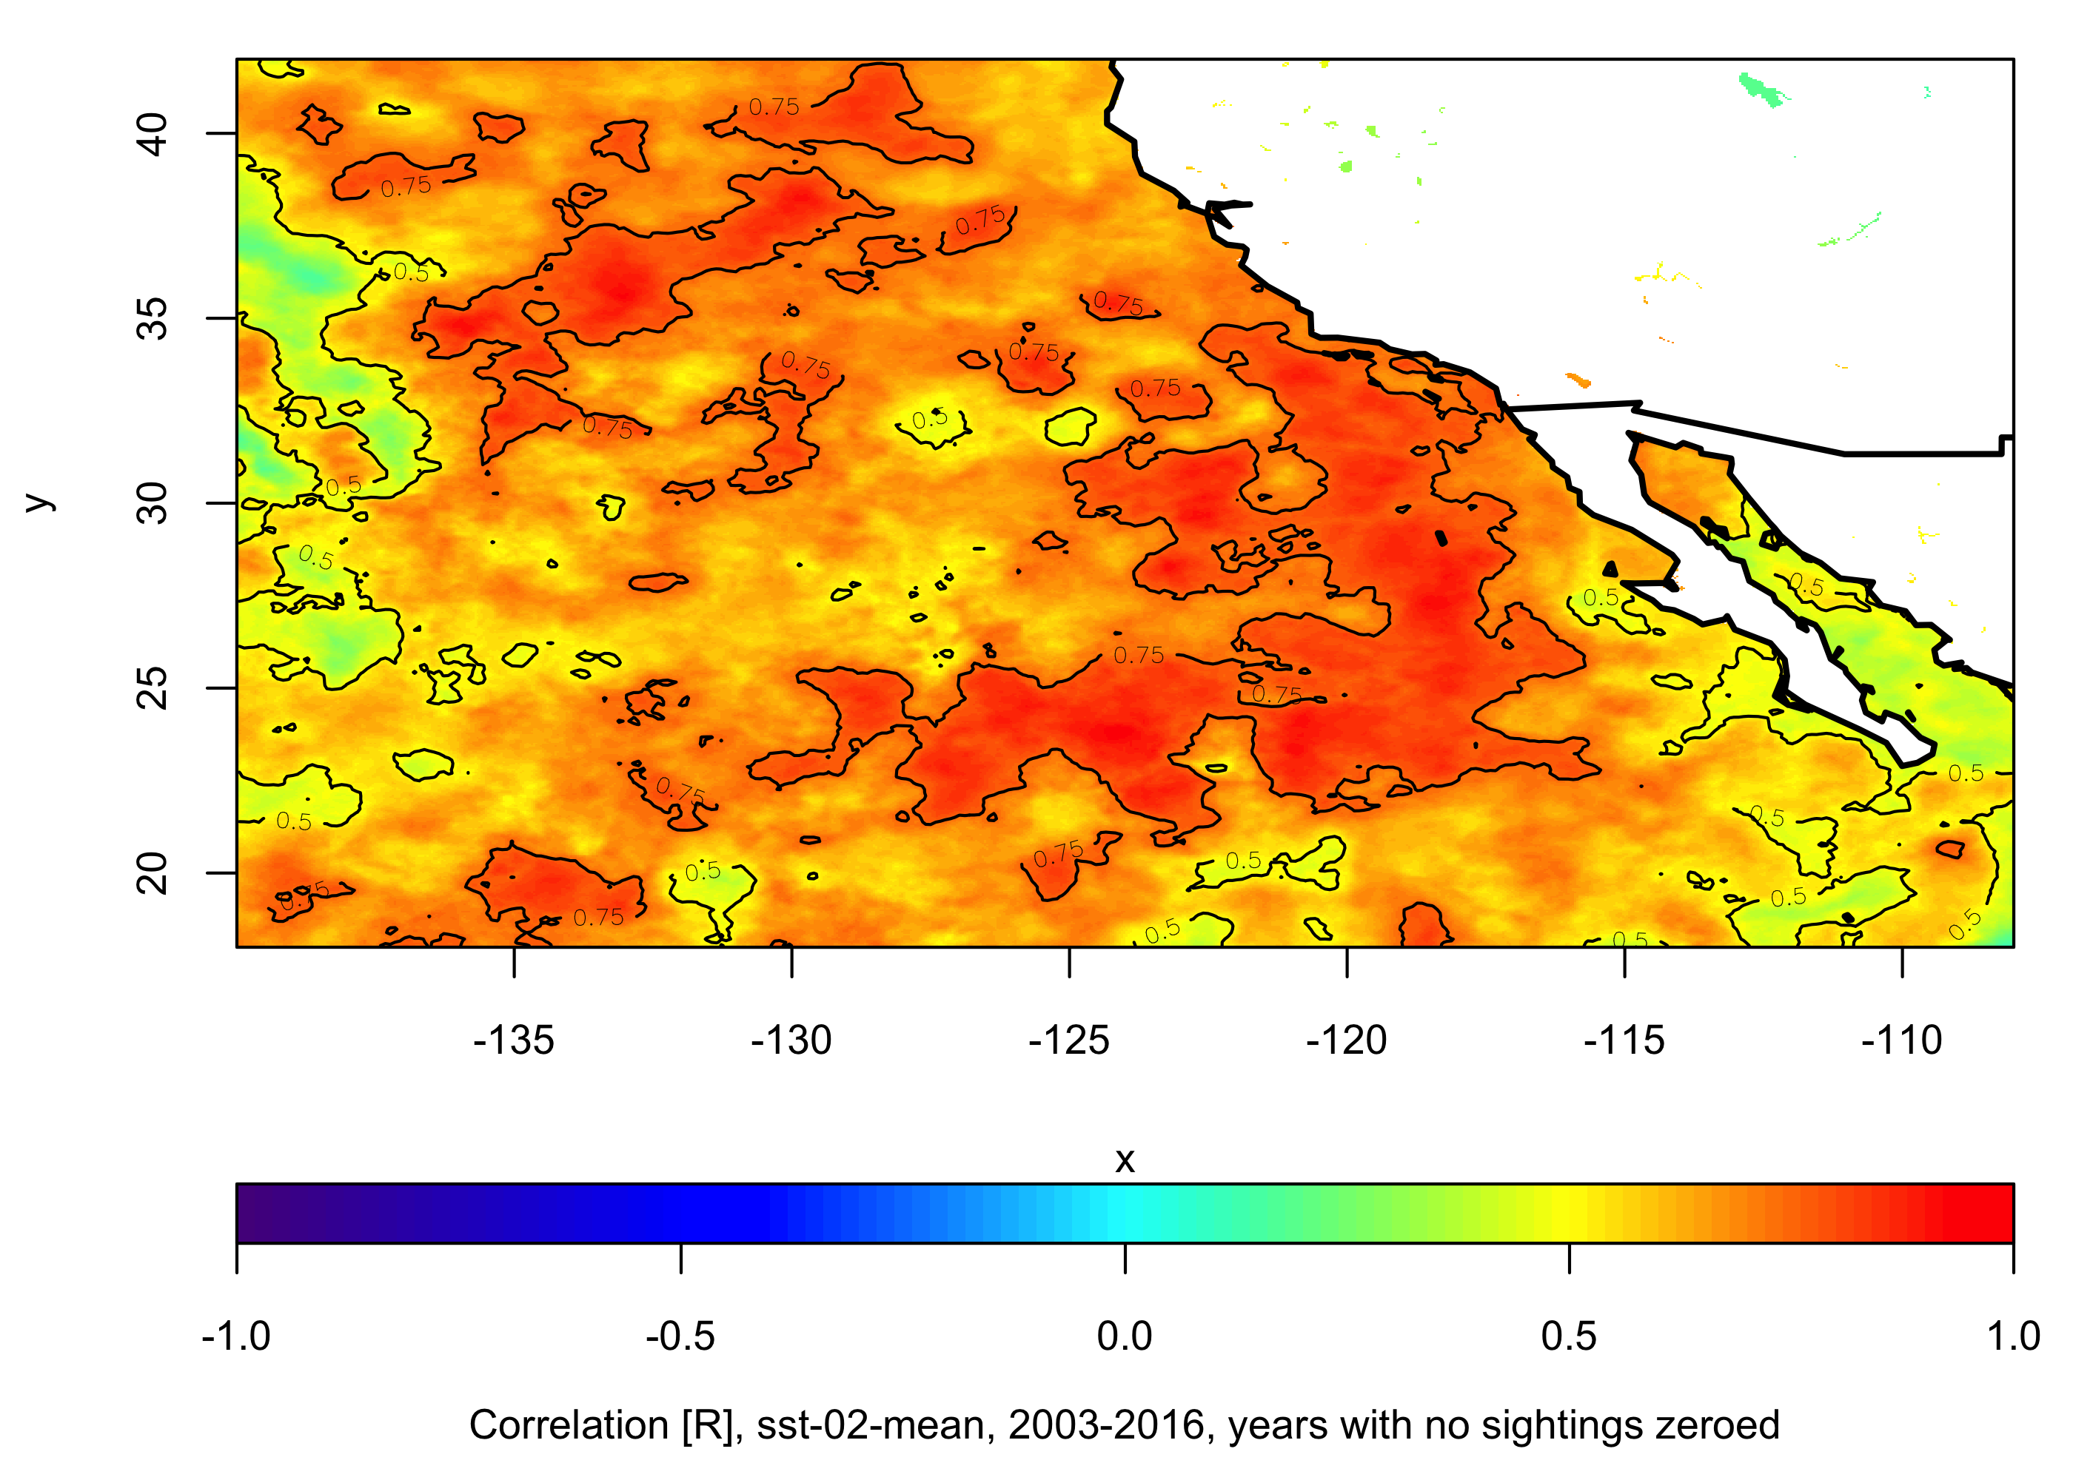
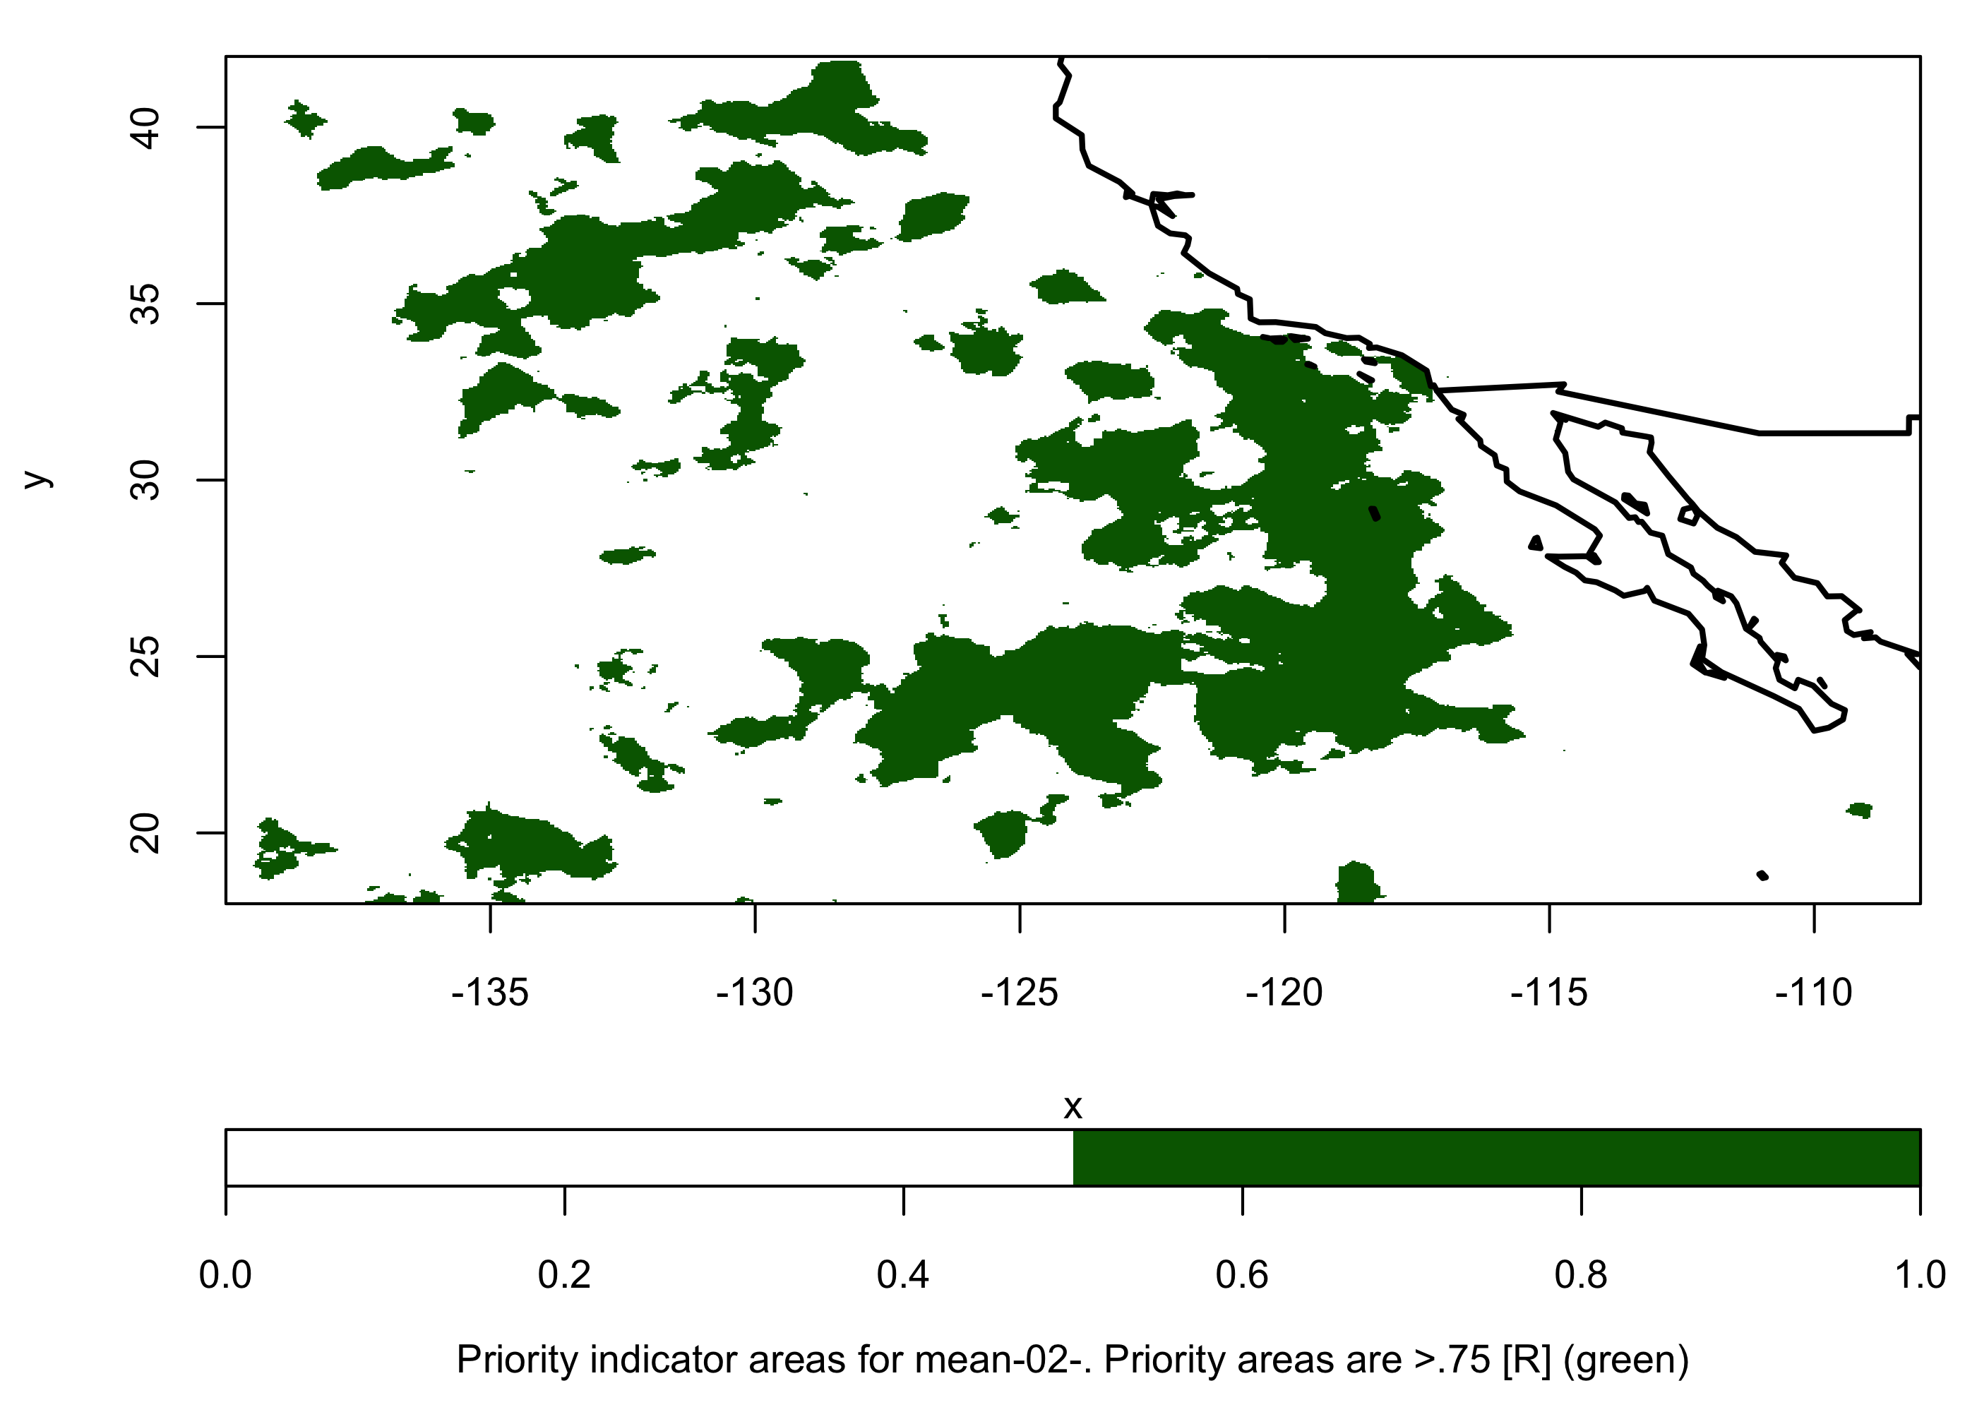
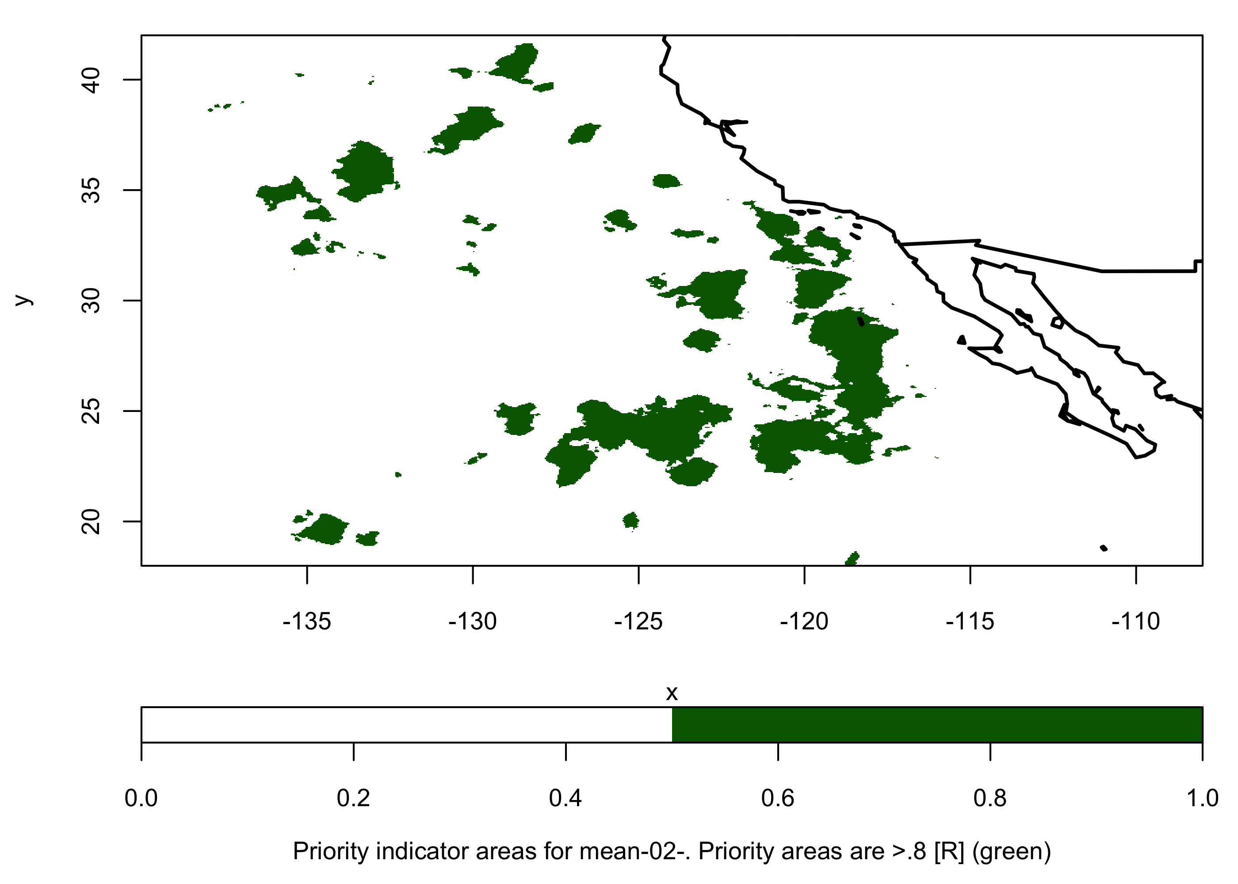
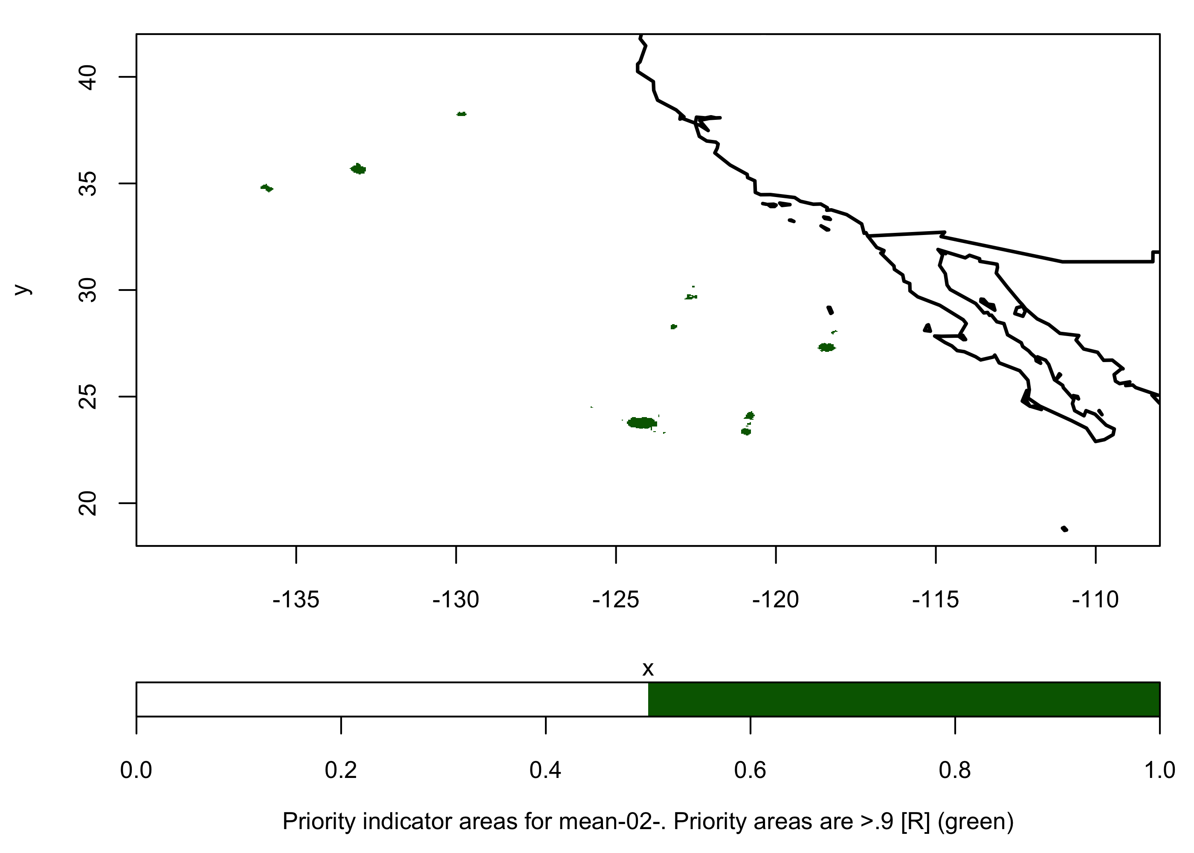
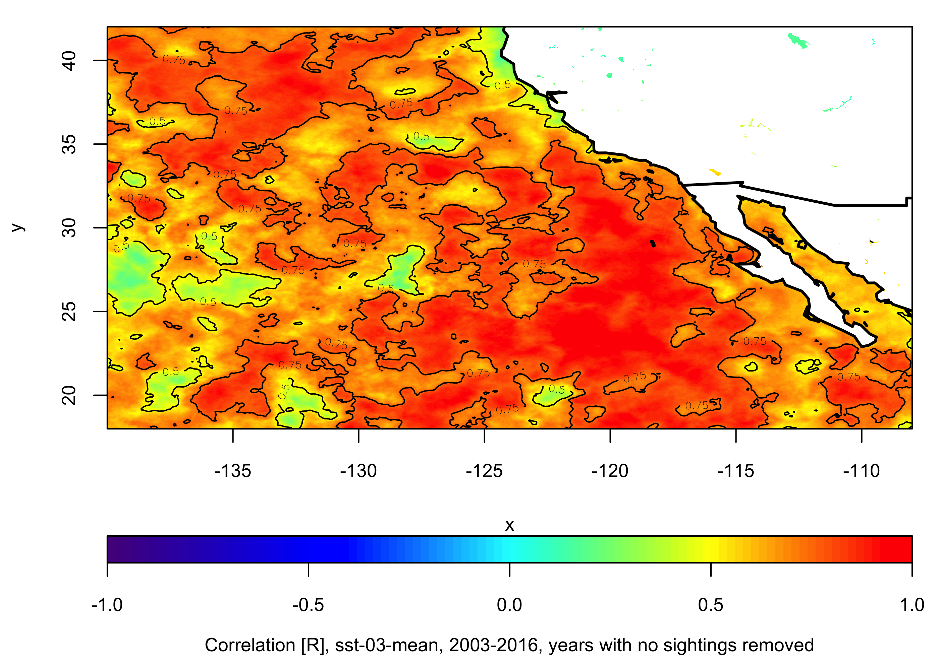
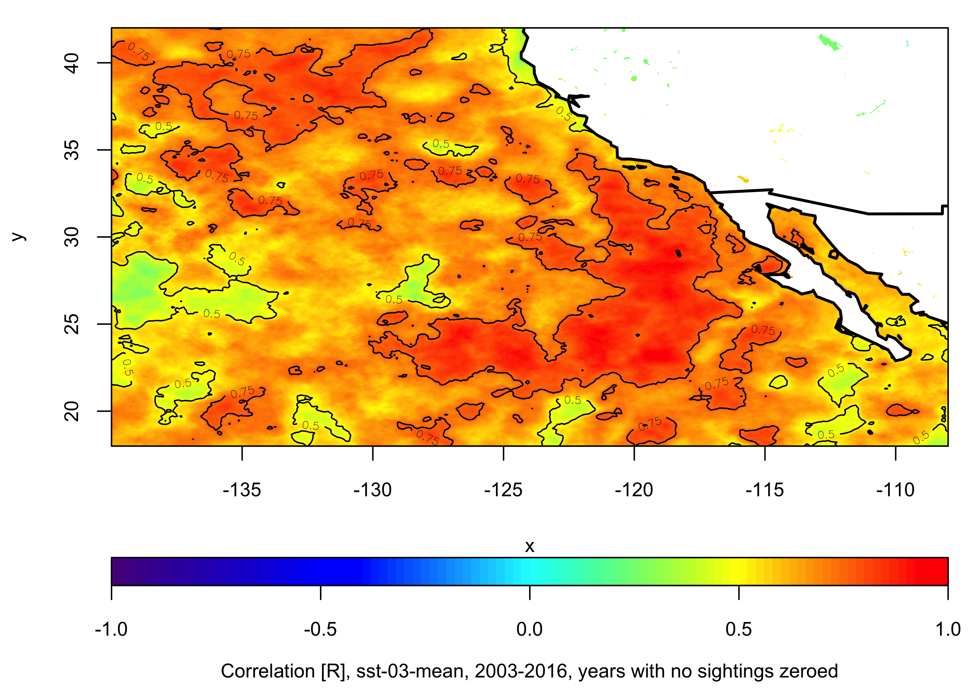
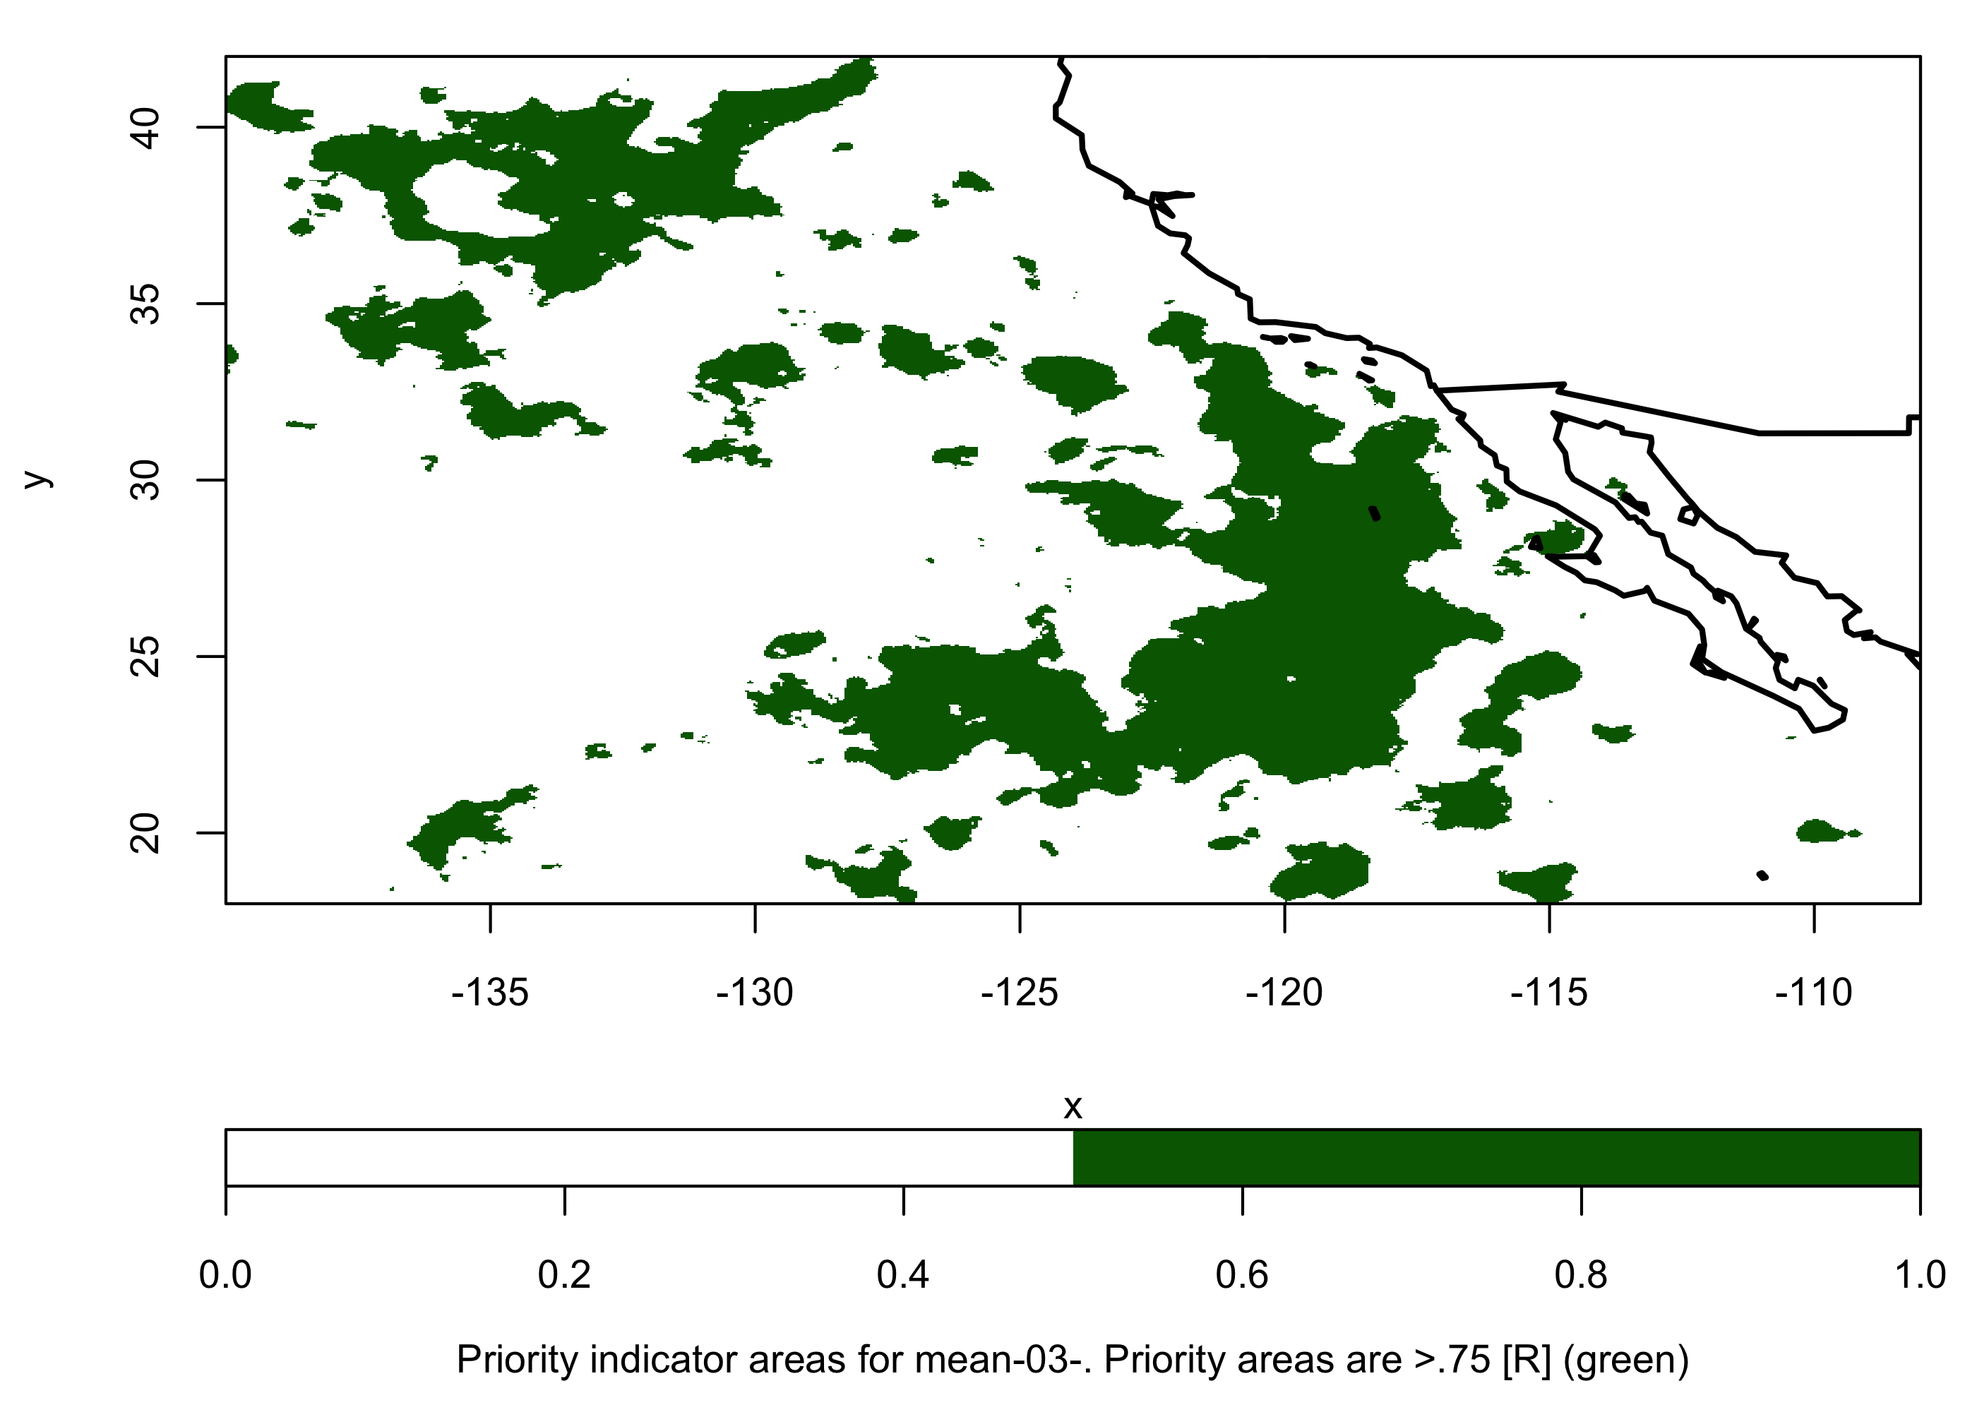
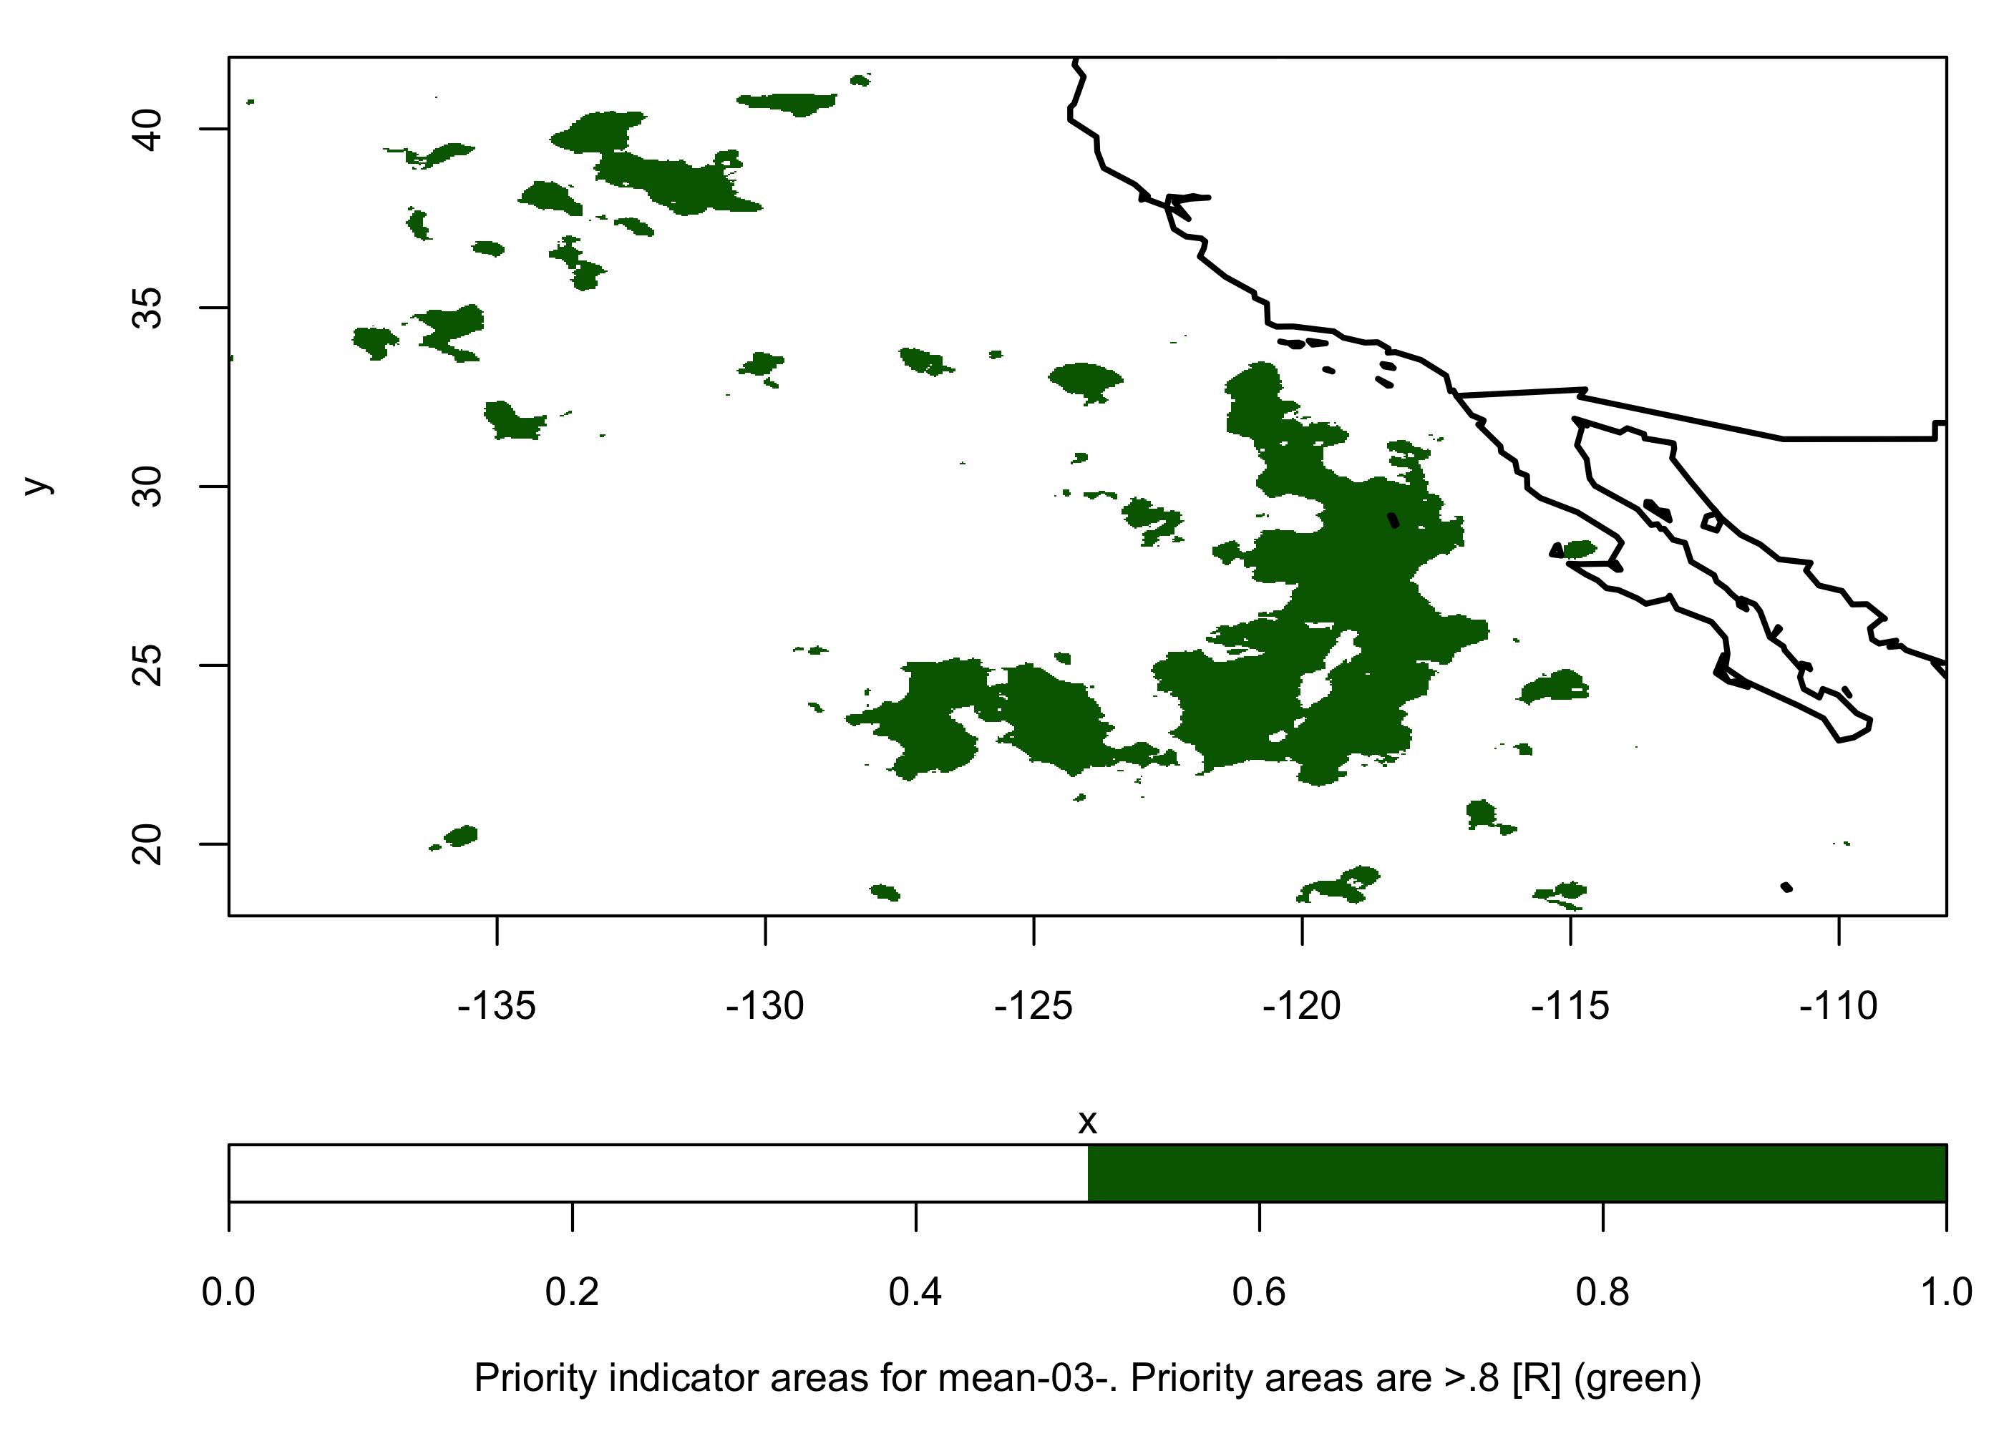
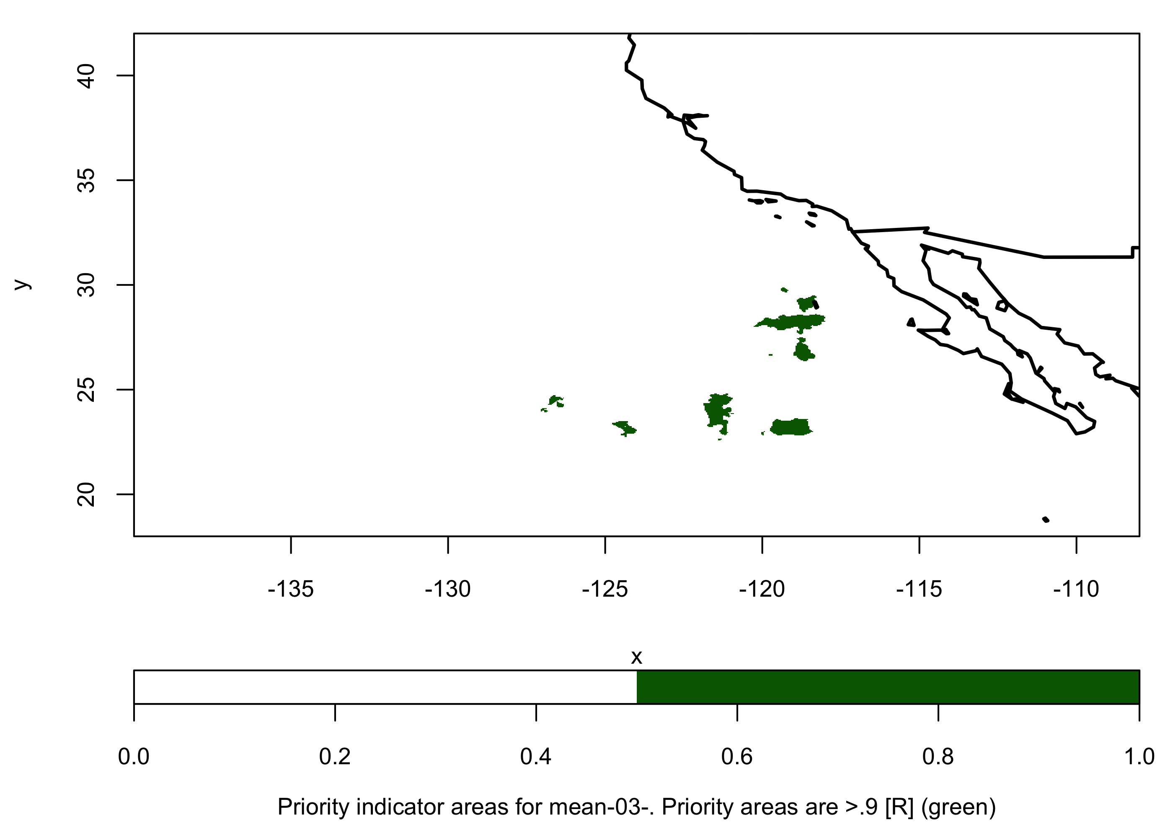
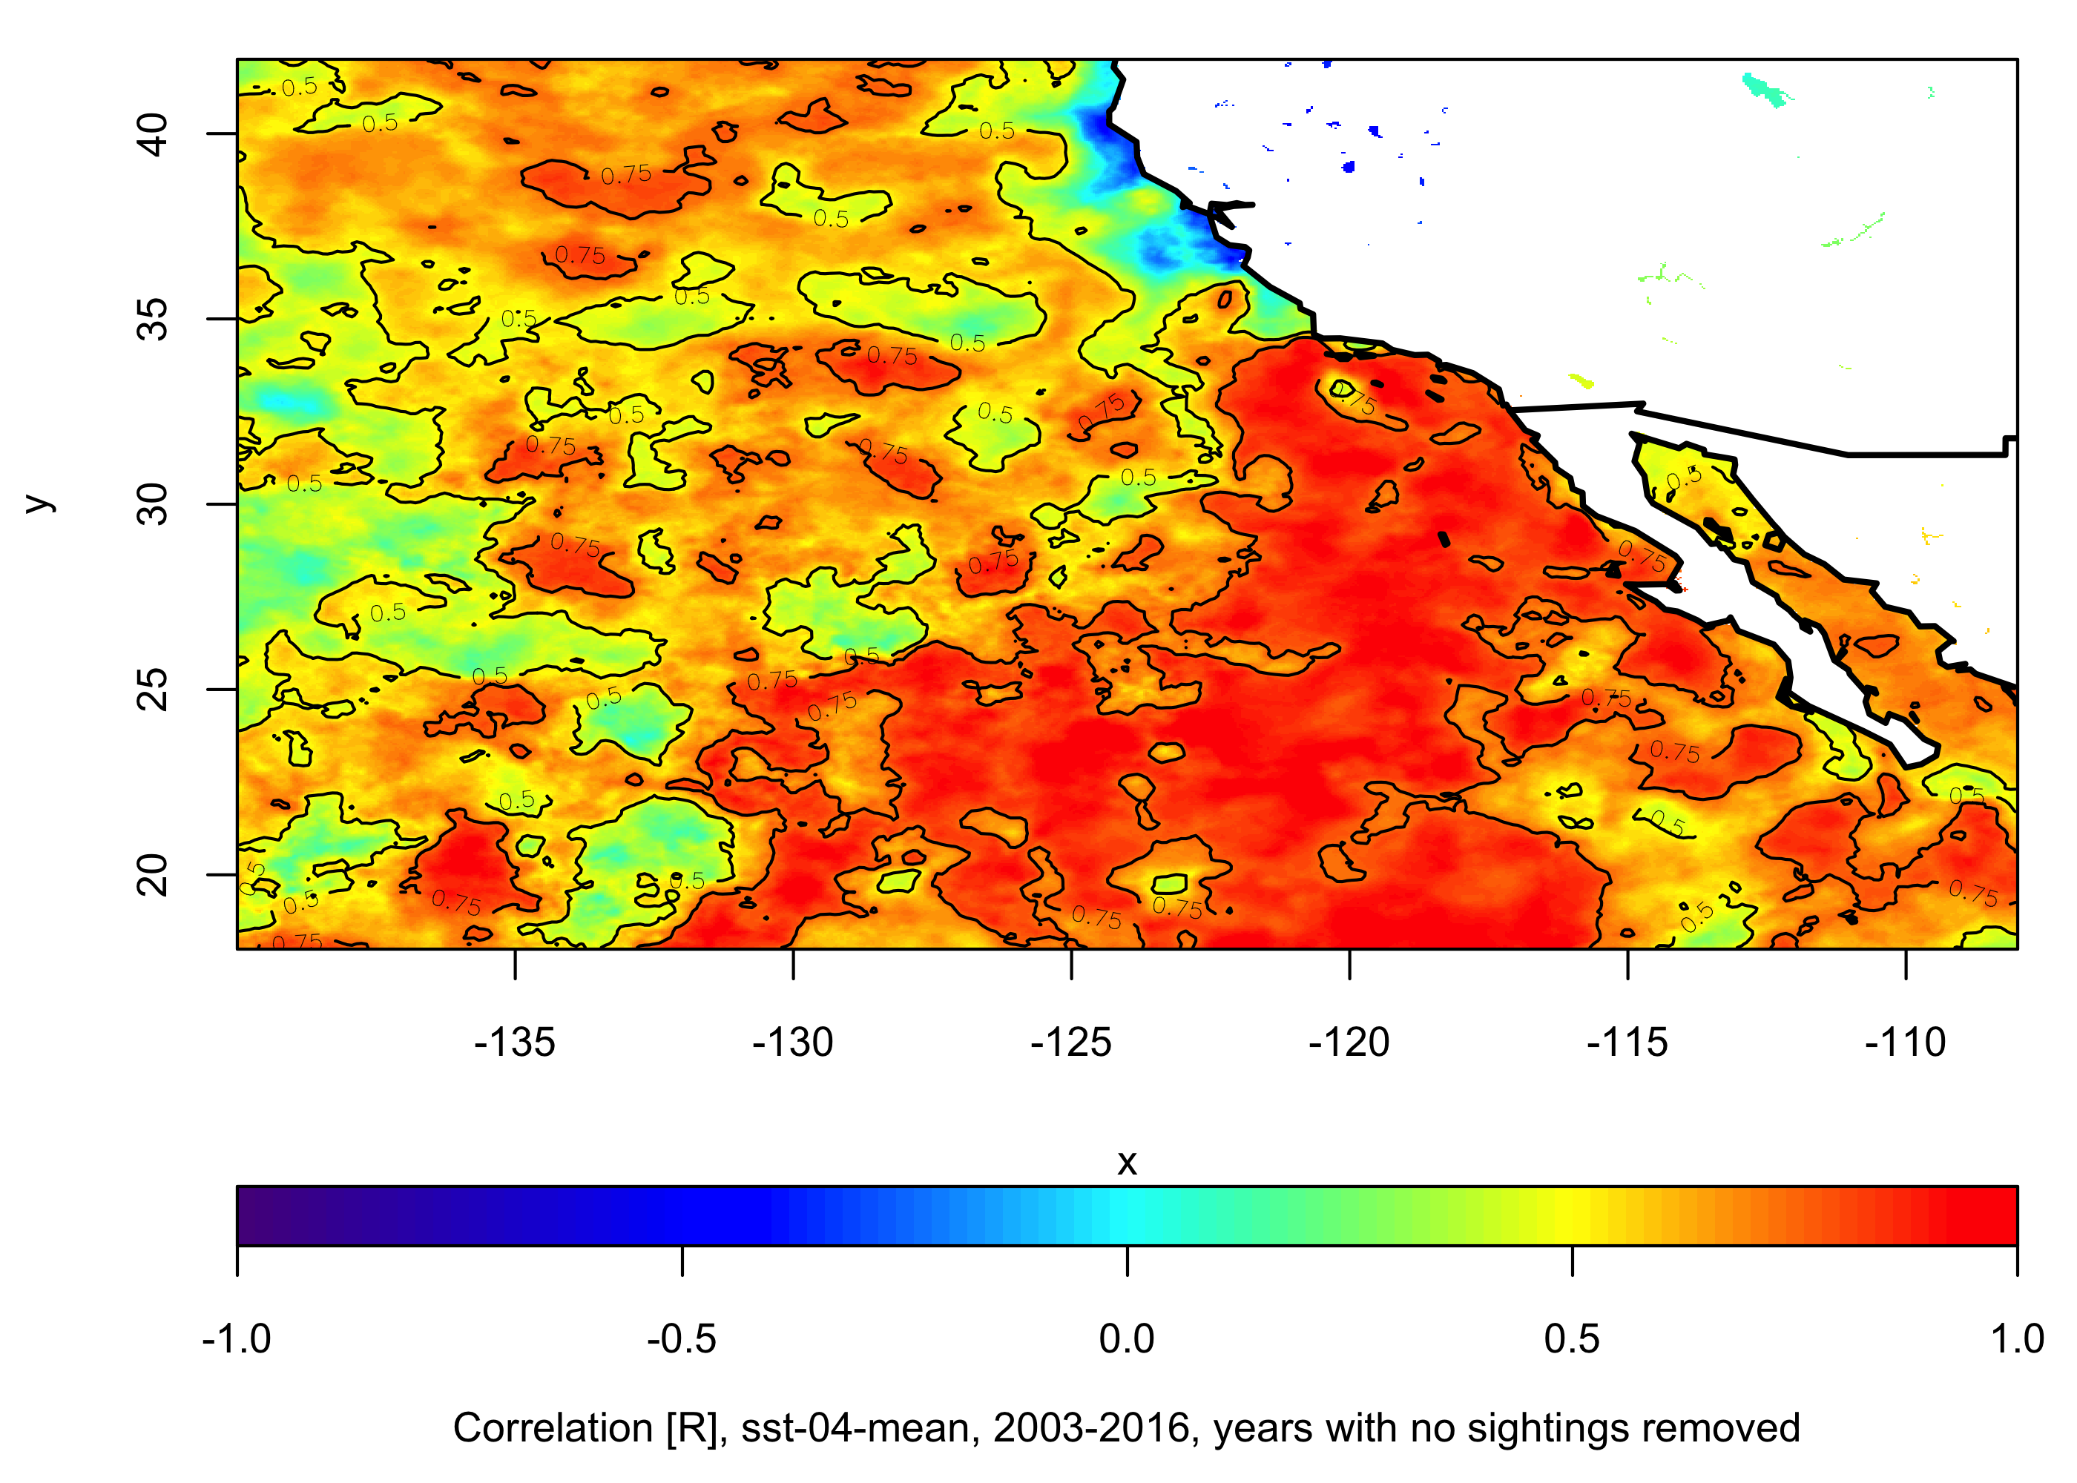
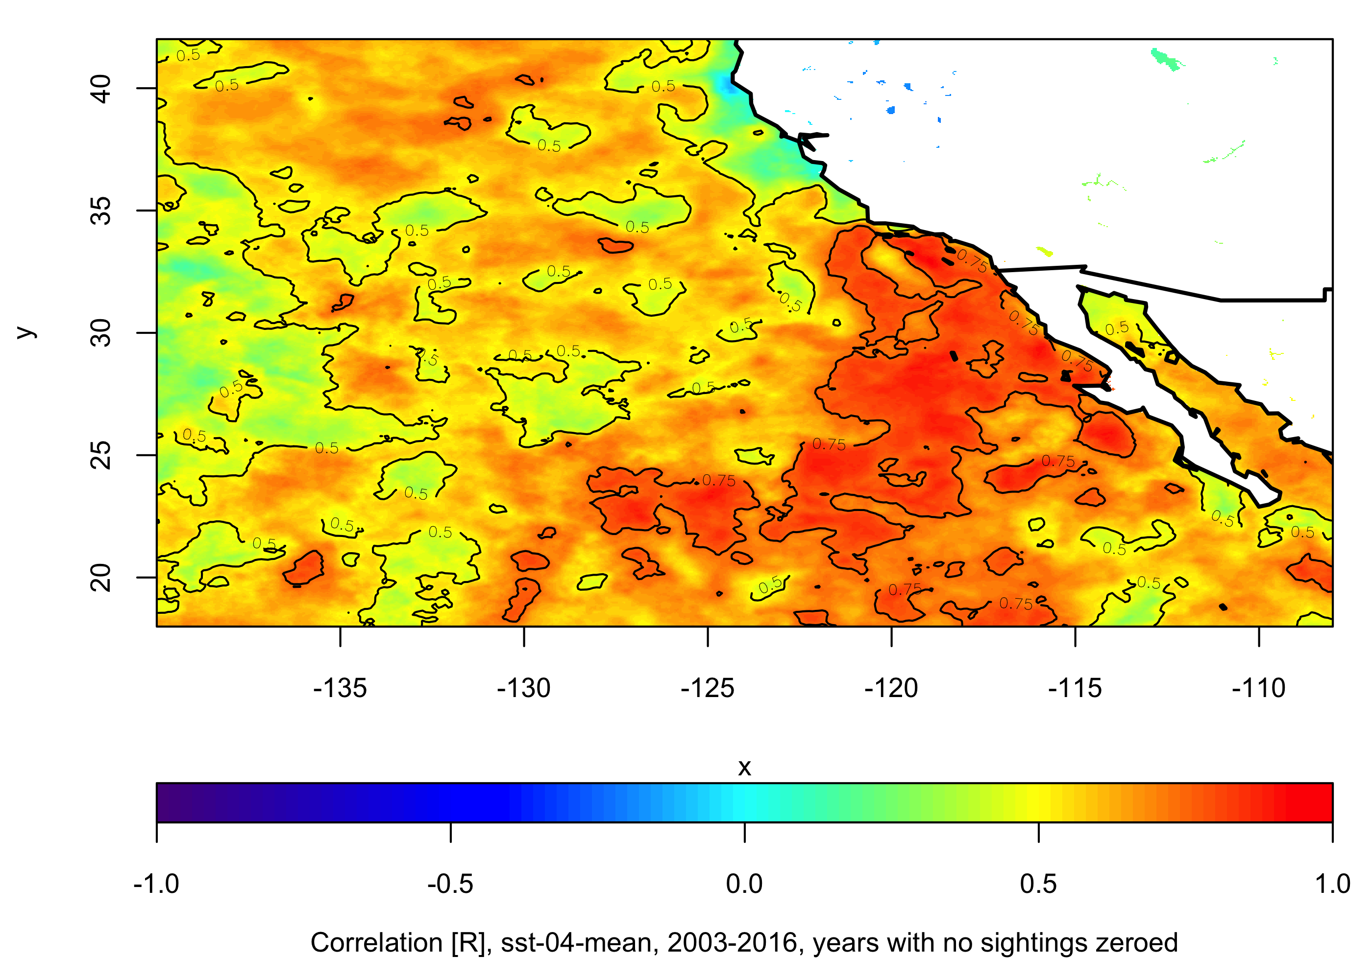
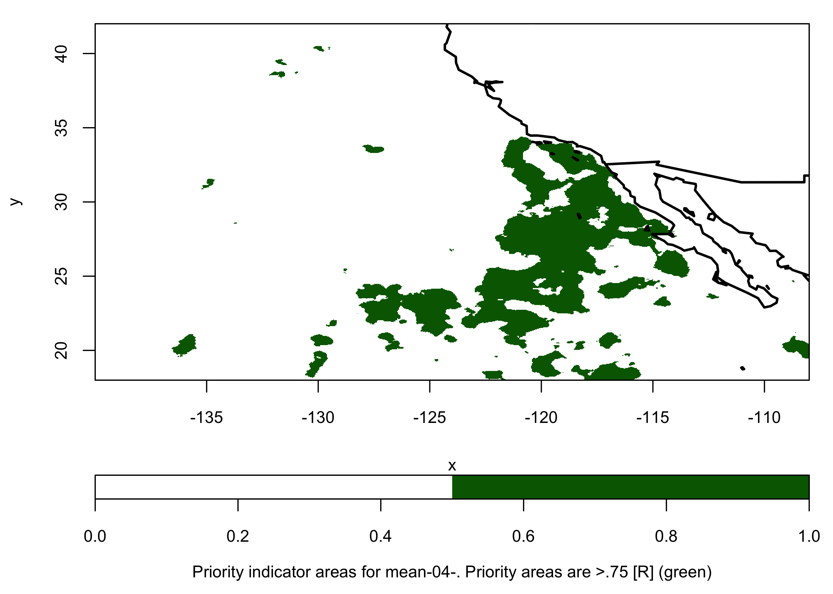
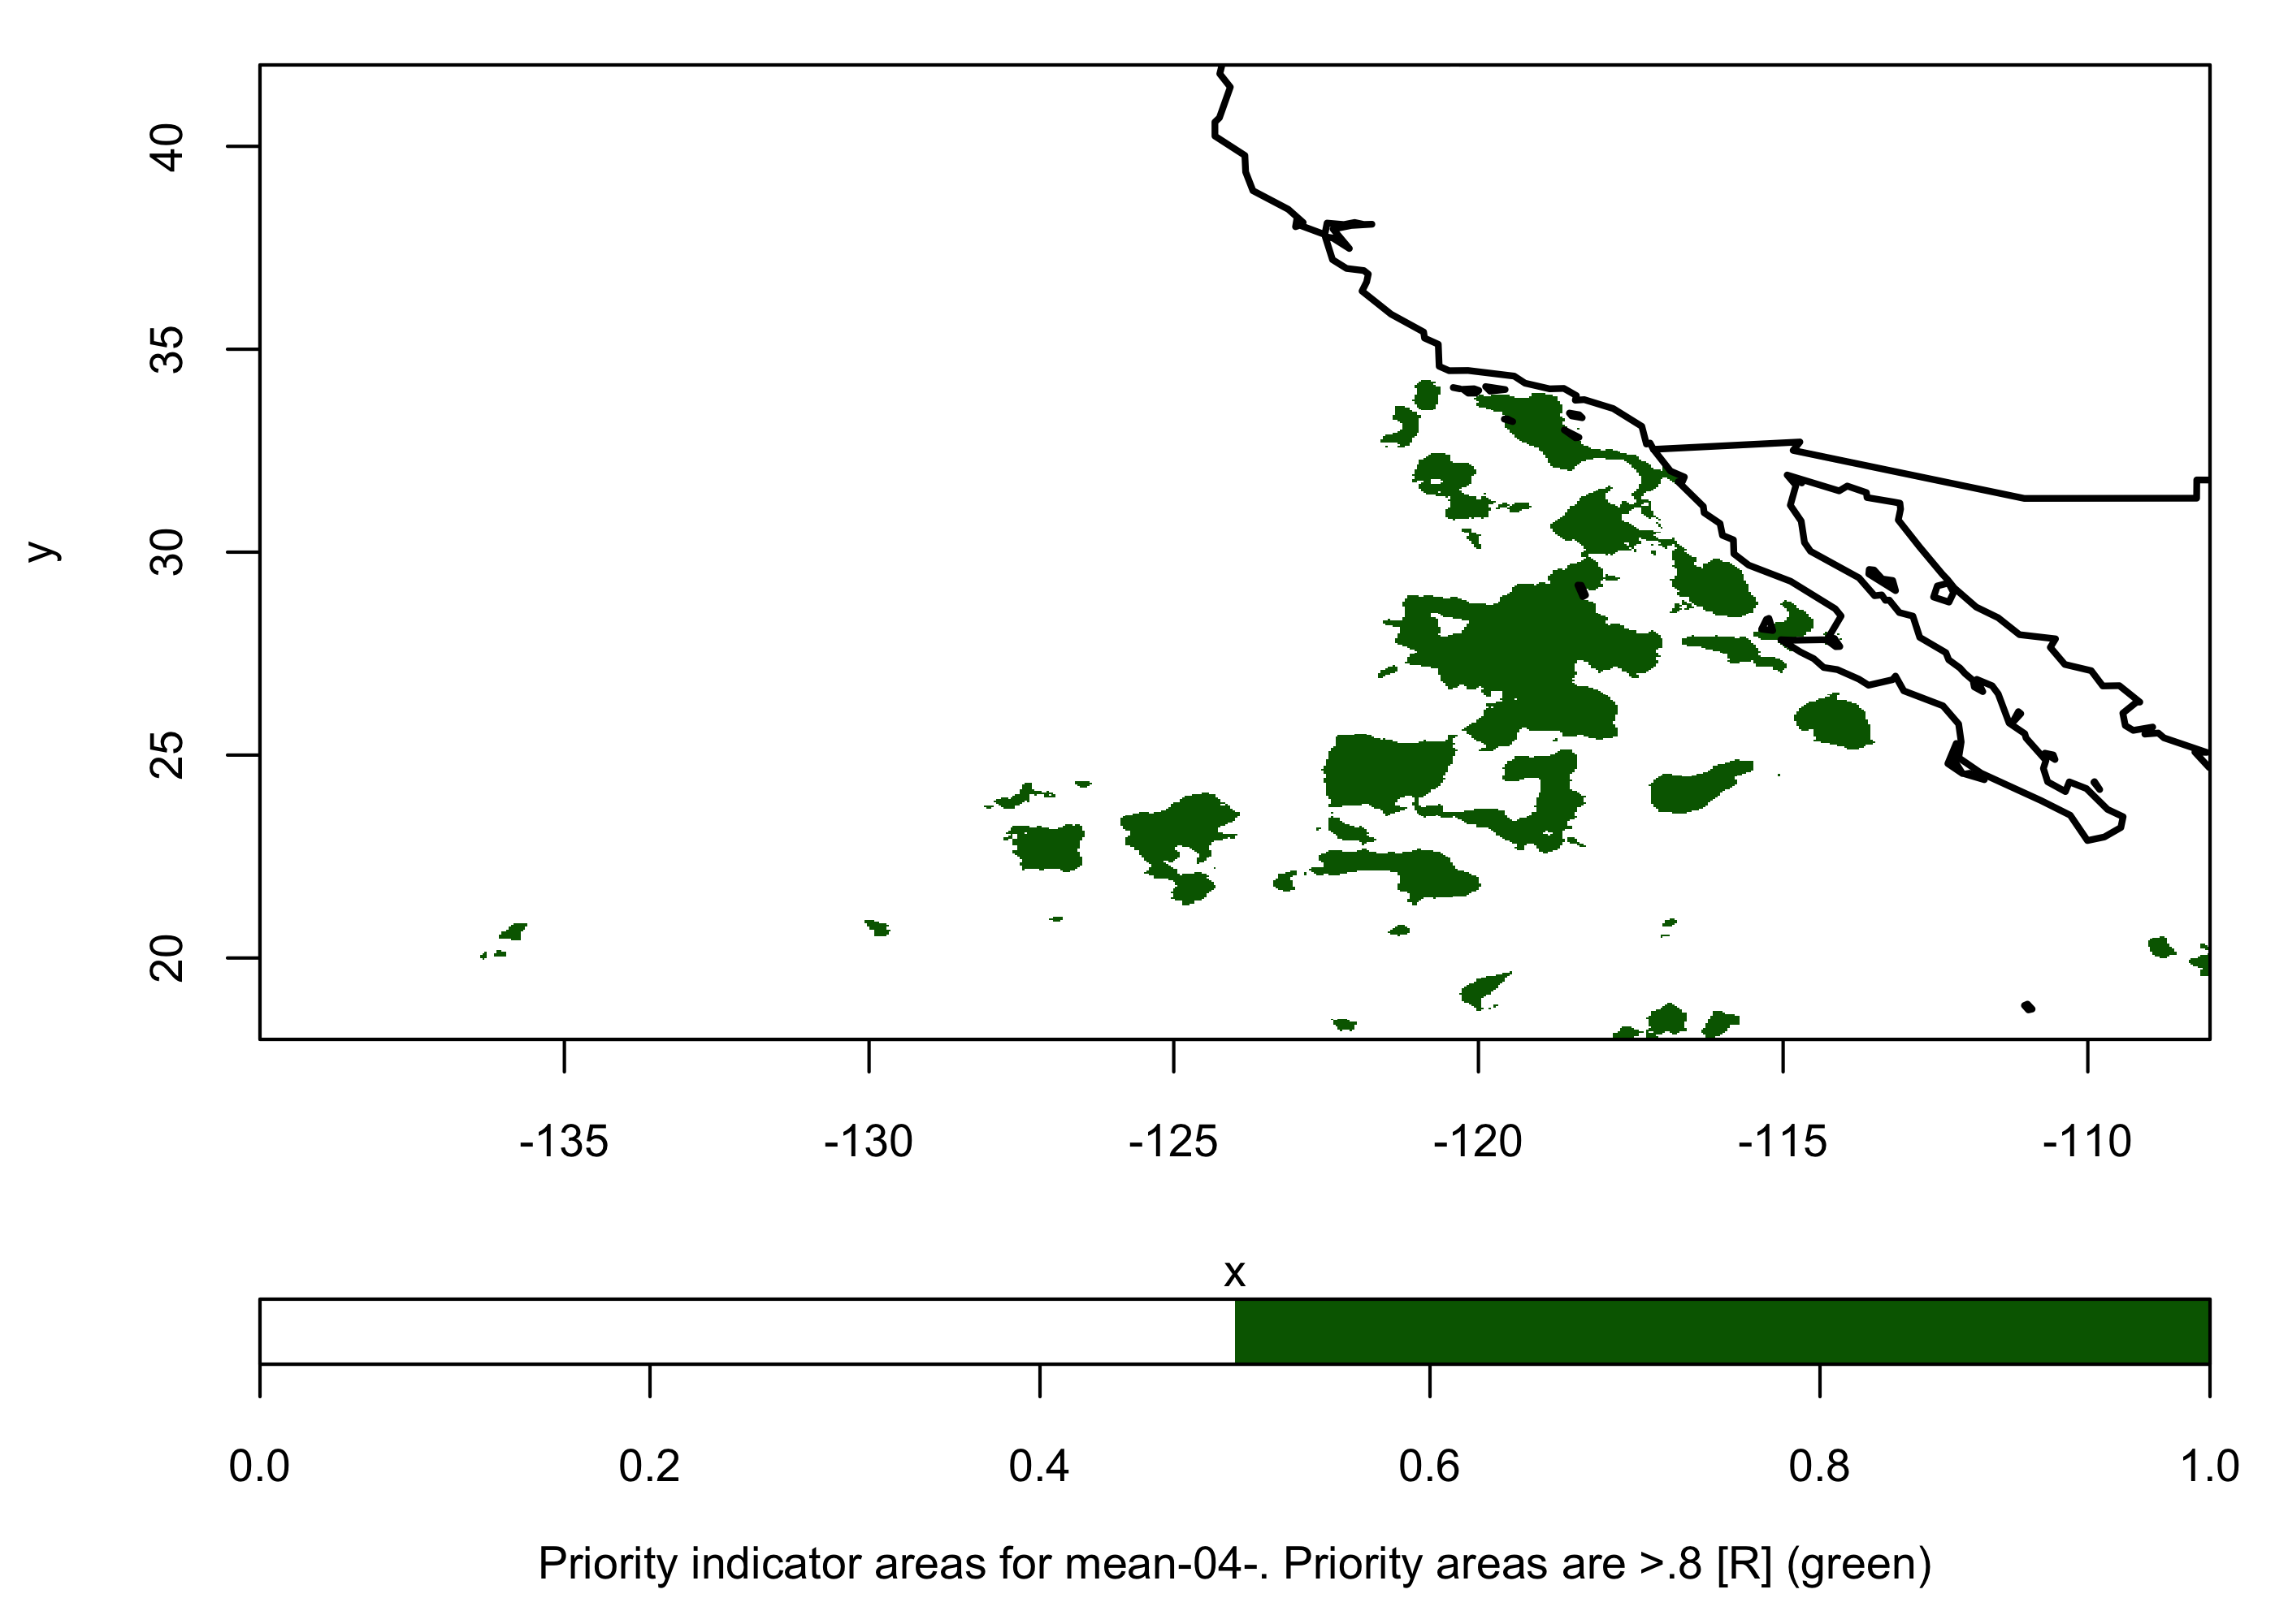
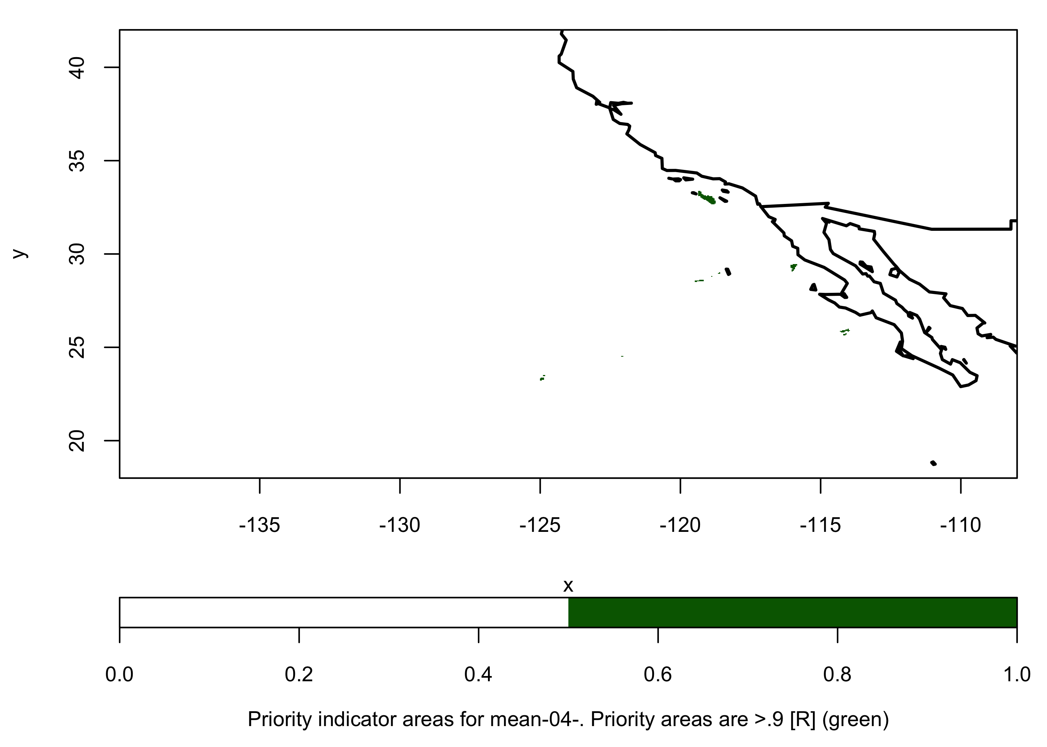
[R] no sightings removed
[R] no sightings zeroed
Common areas >.75
Common areas >.8
Common areas >.9
January
February
March
April

Slide 2
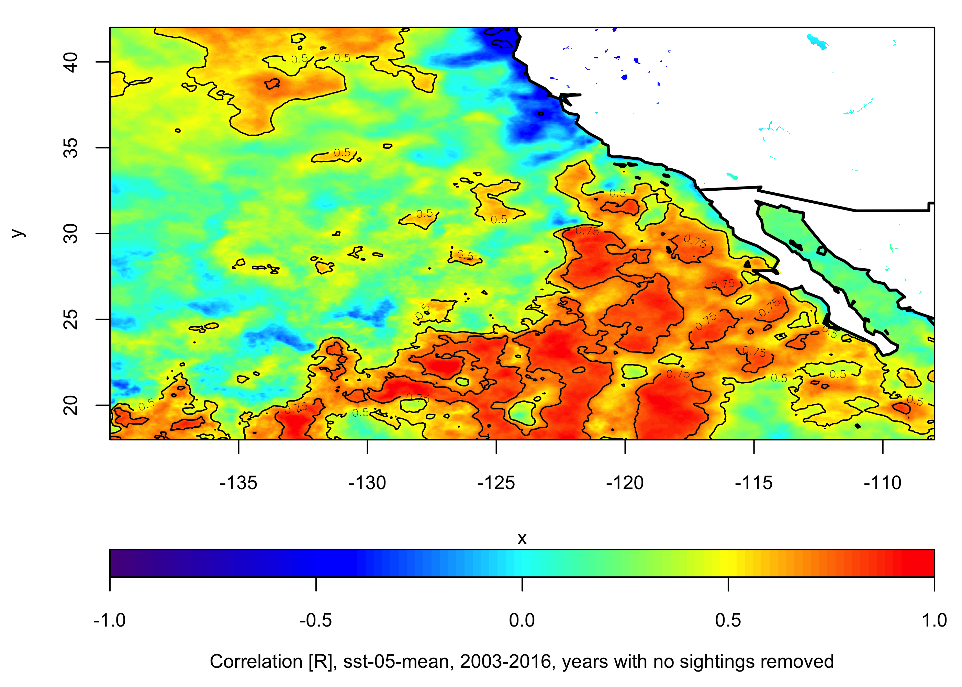
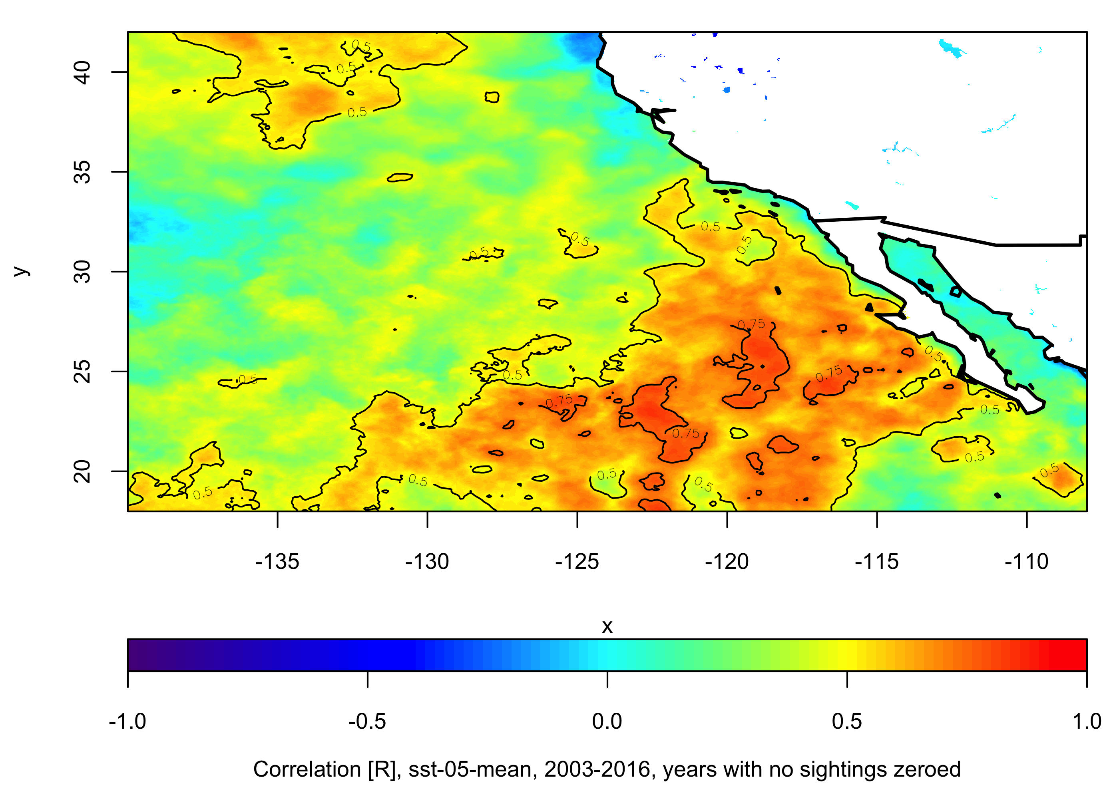
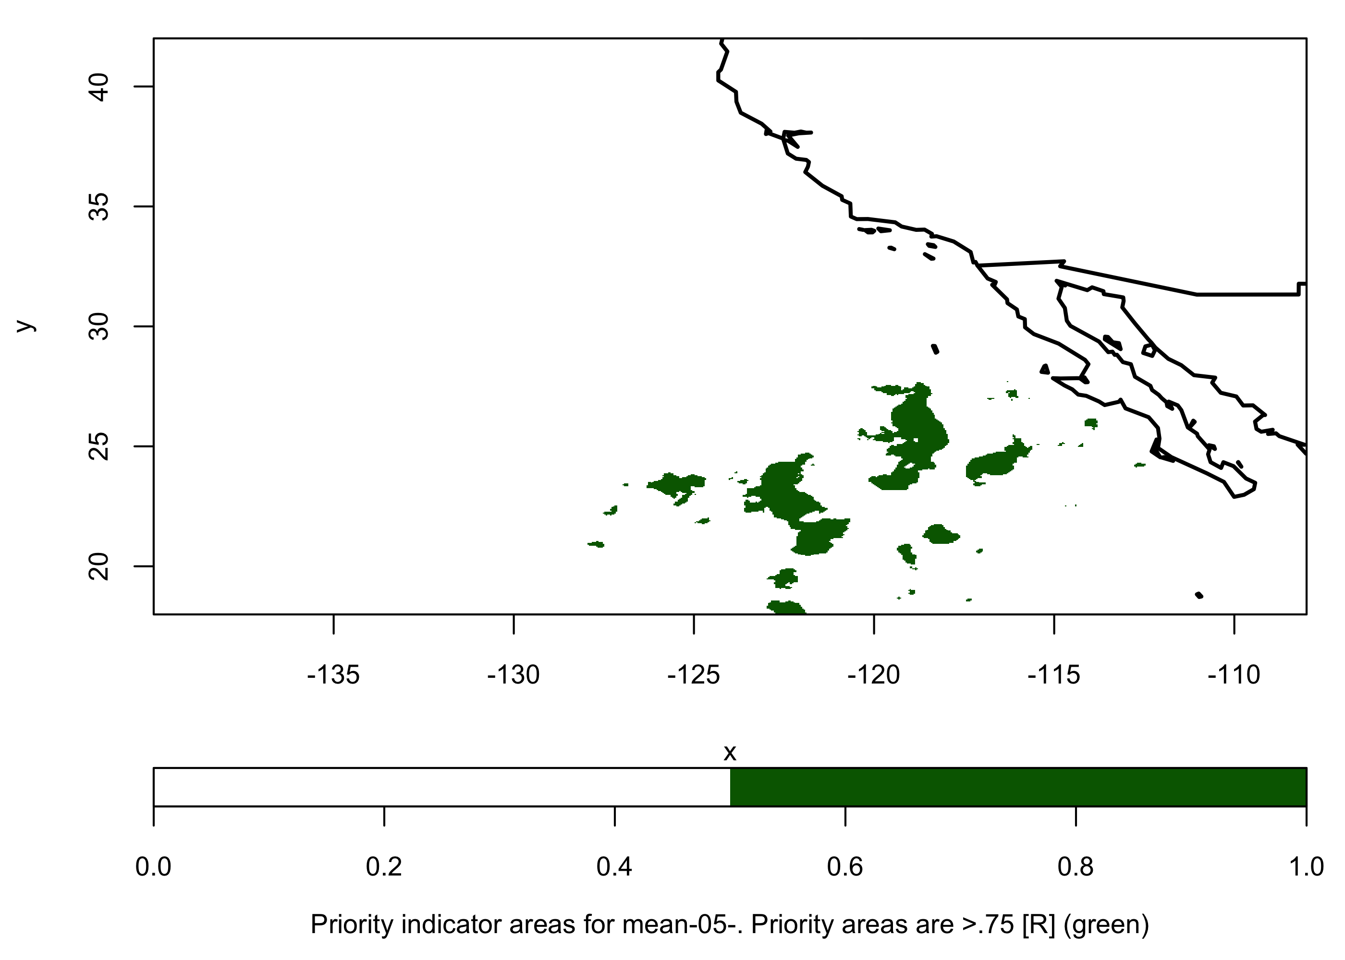
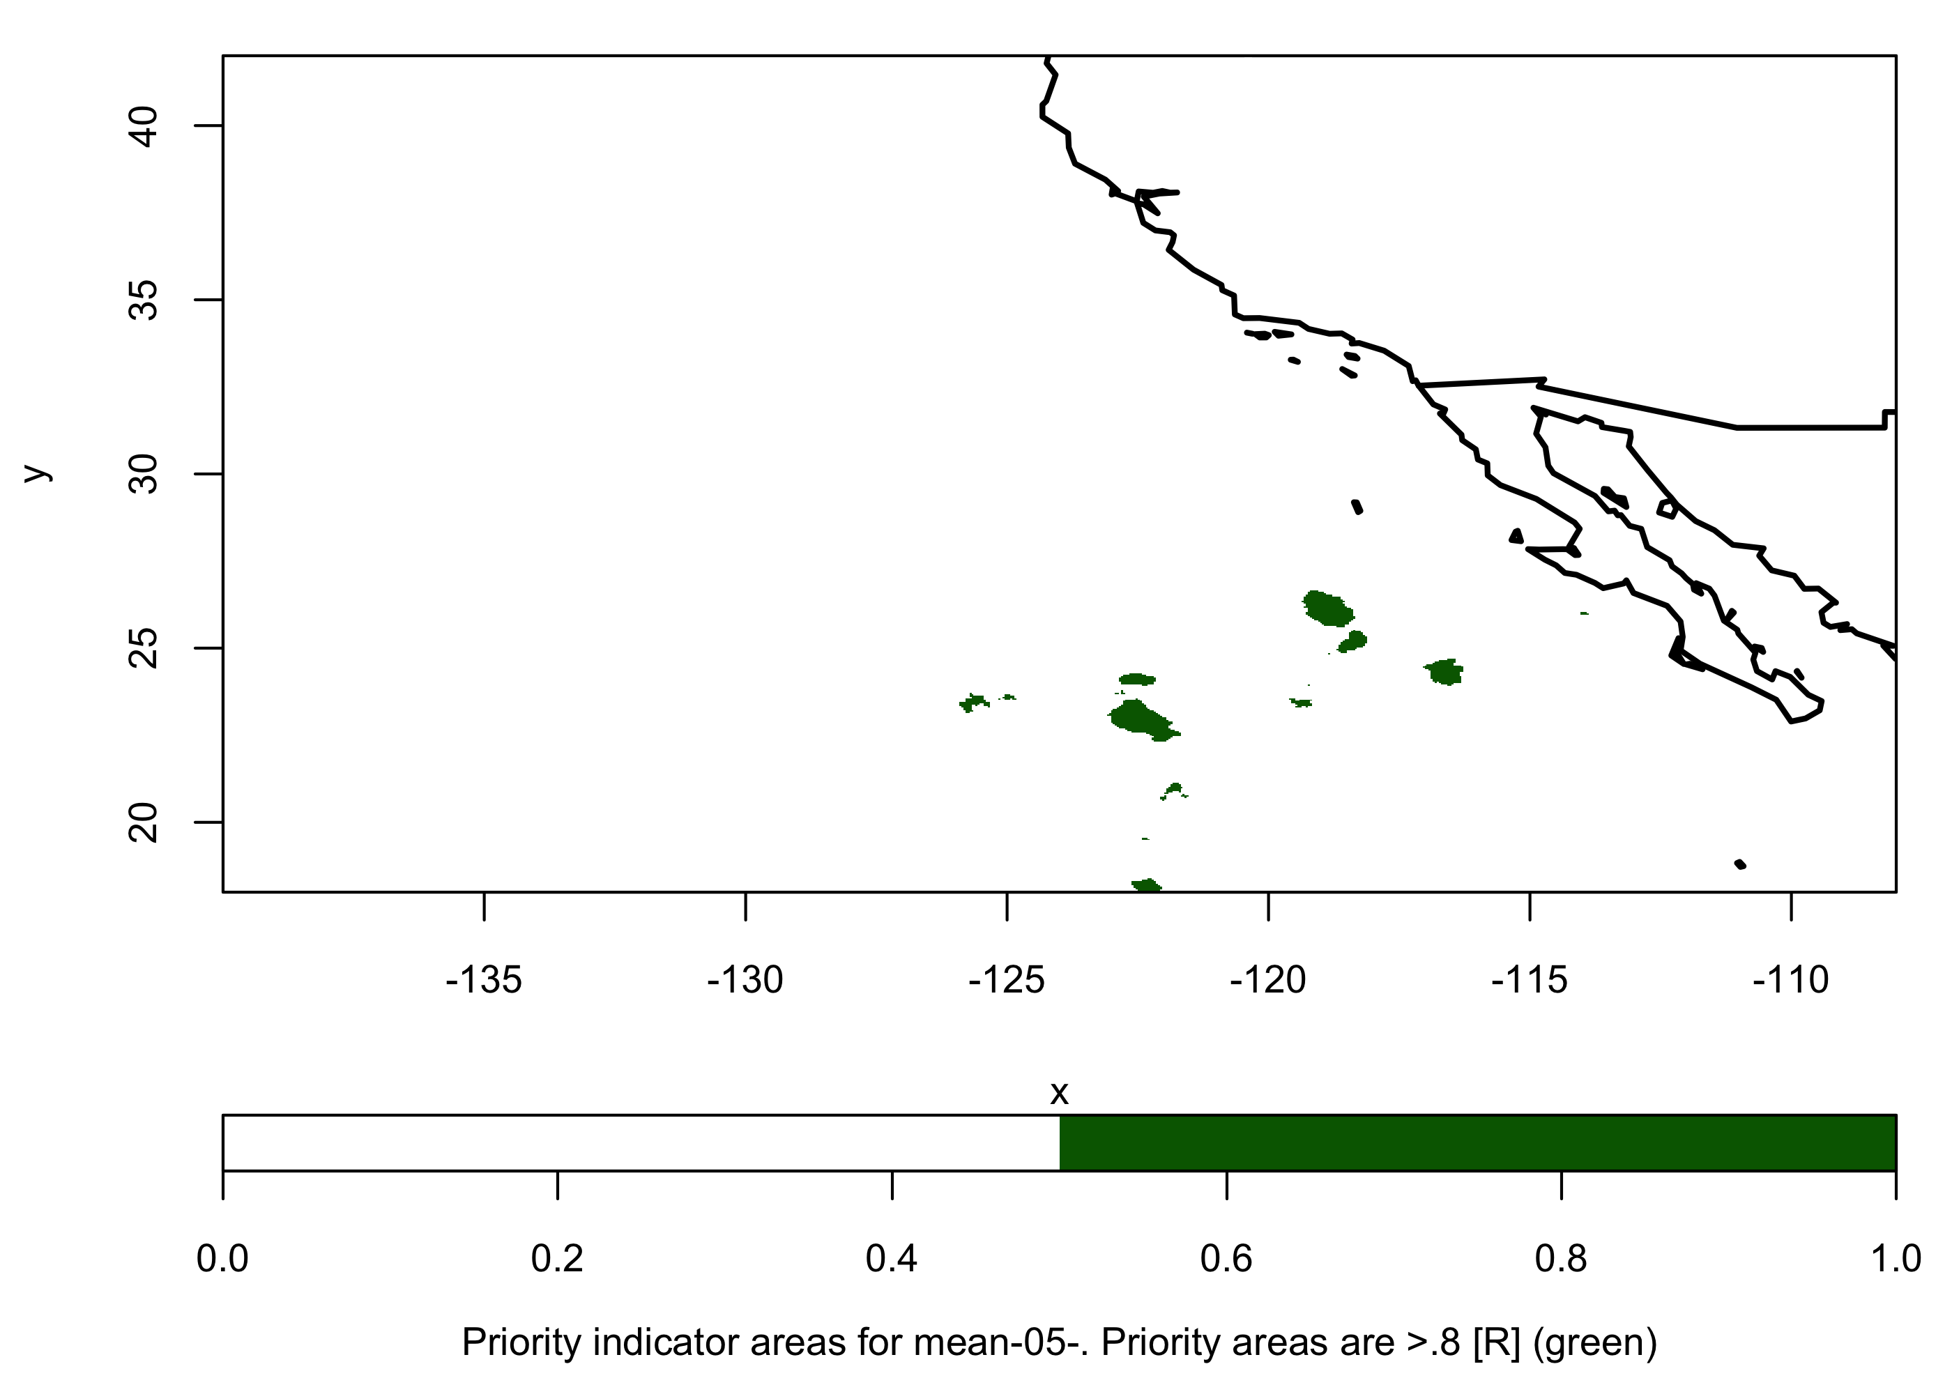

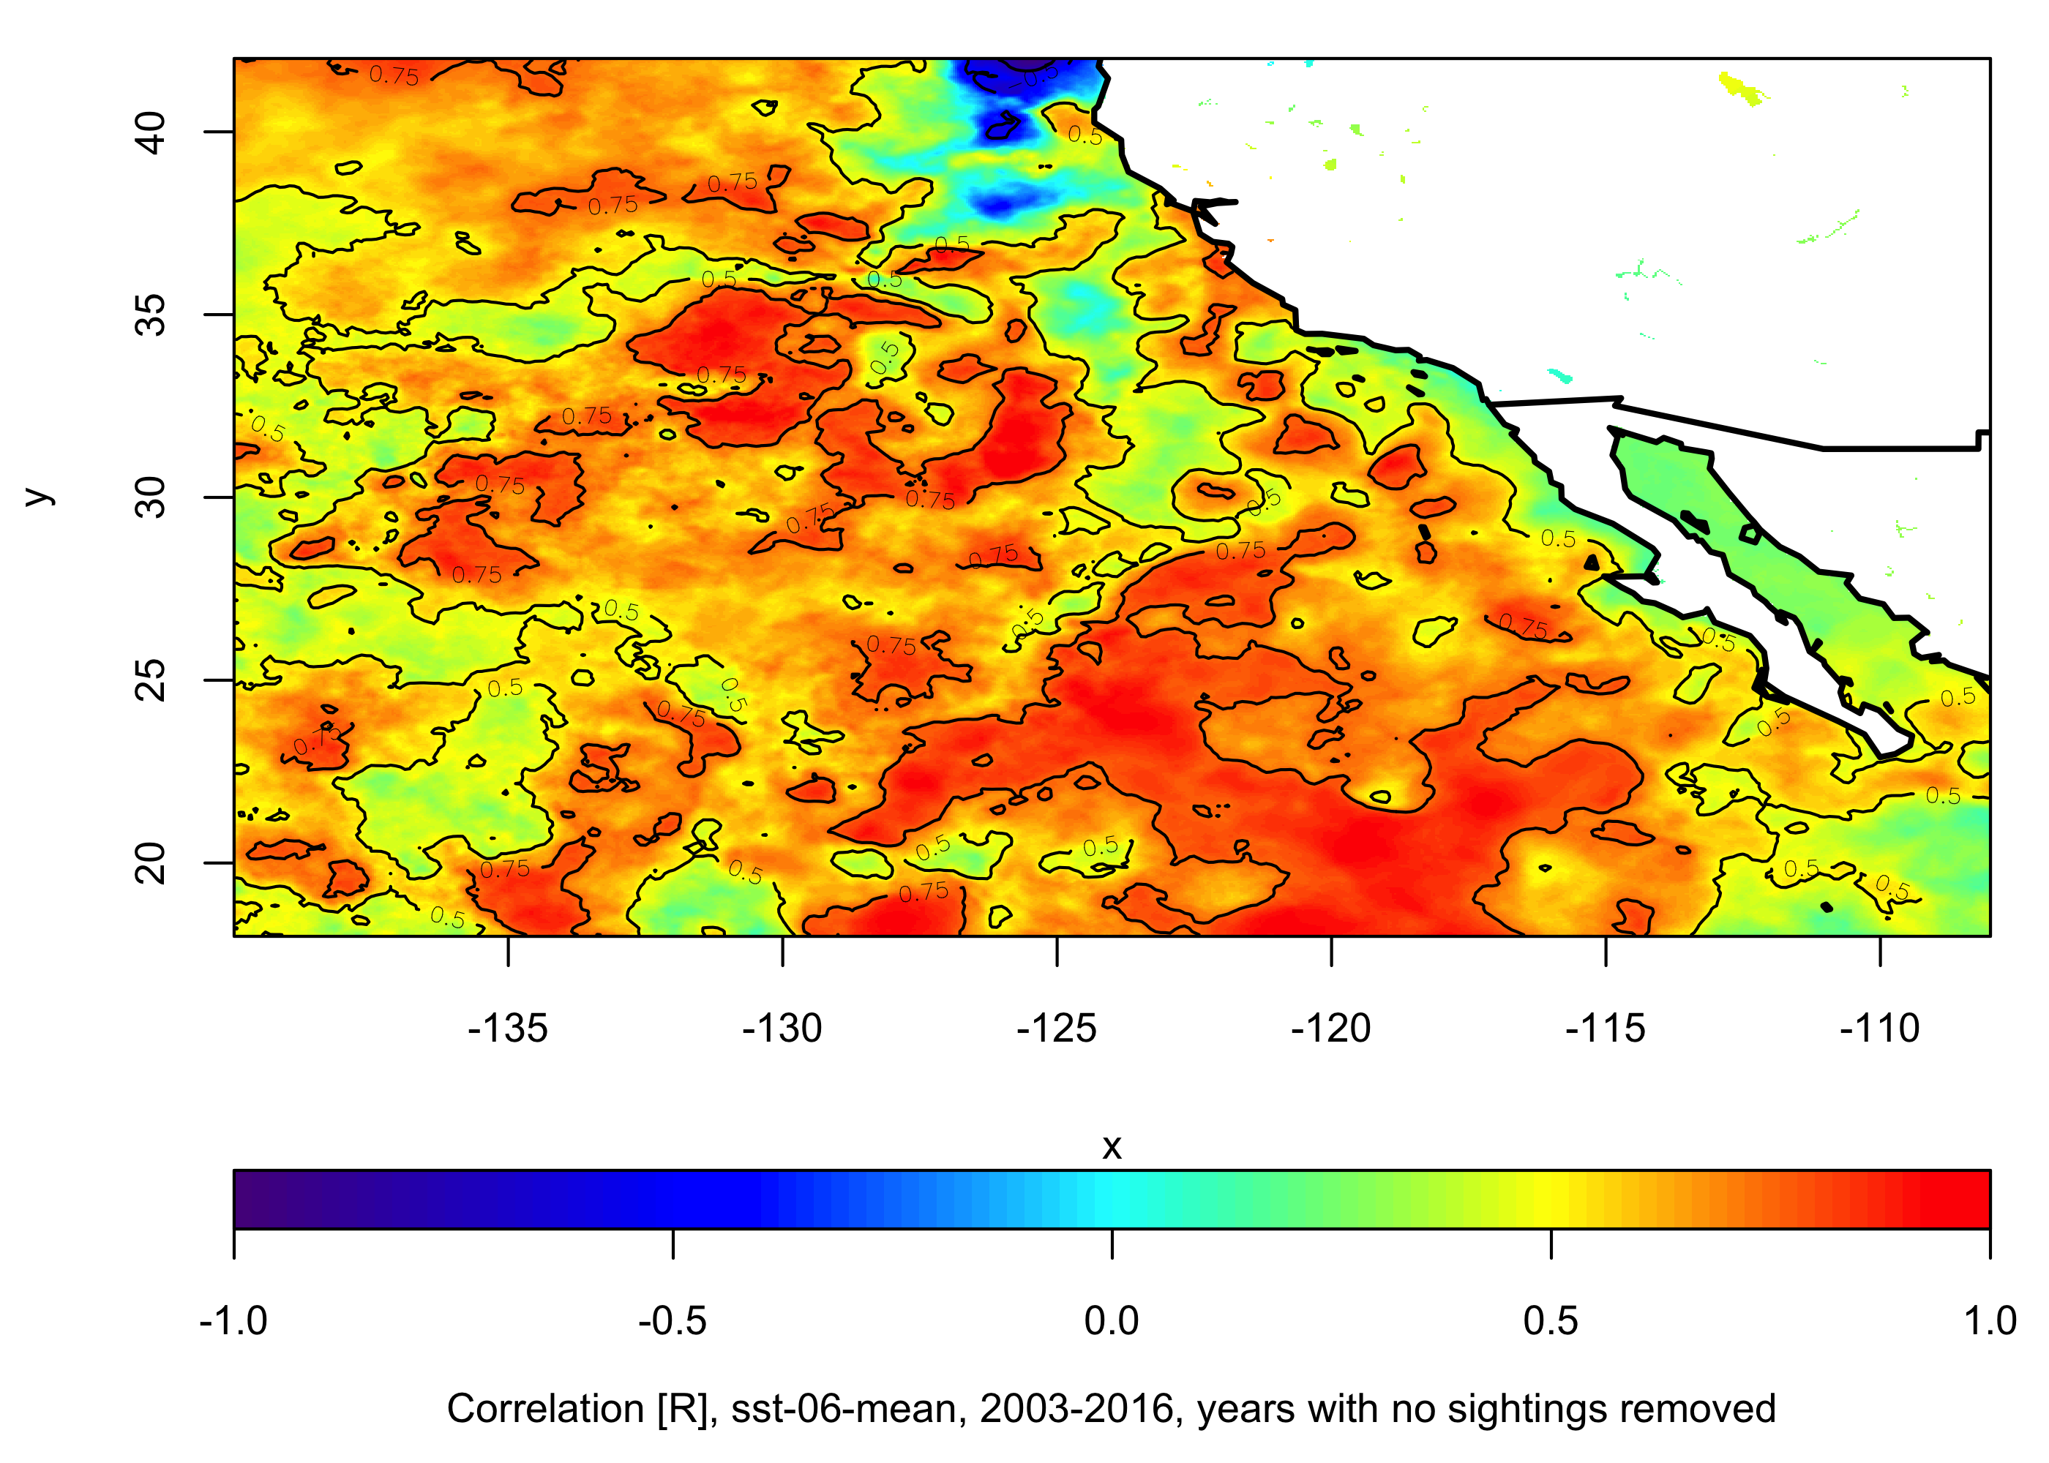
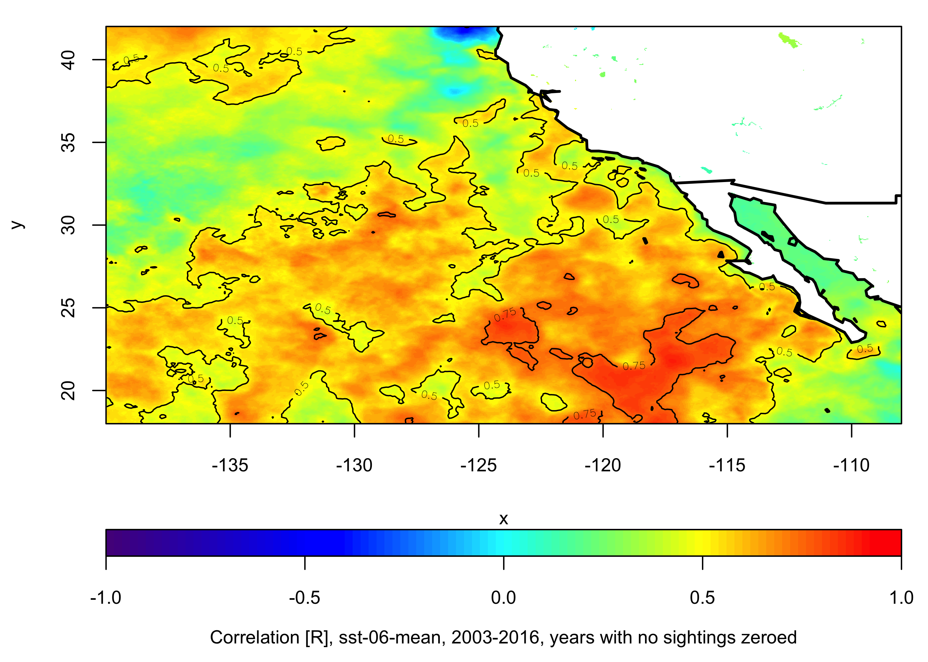
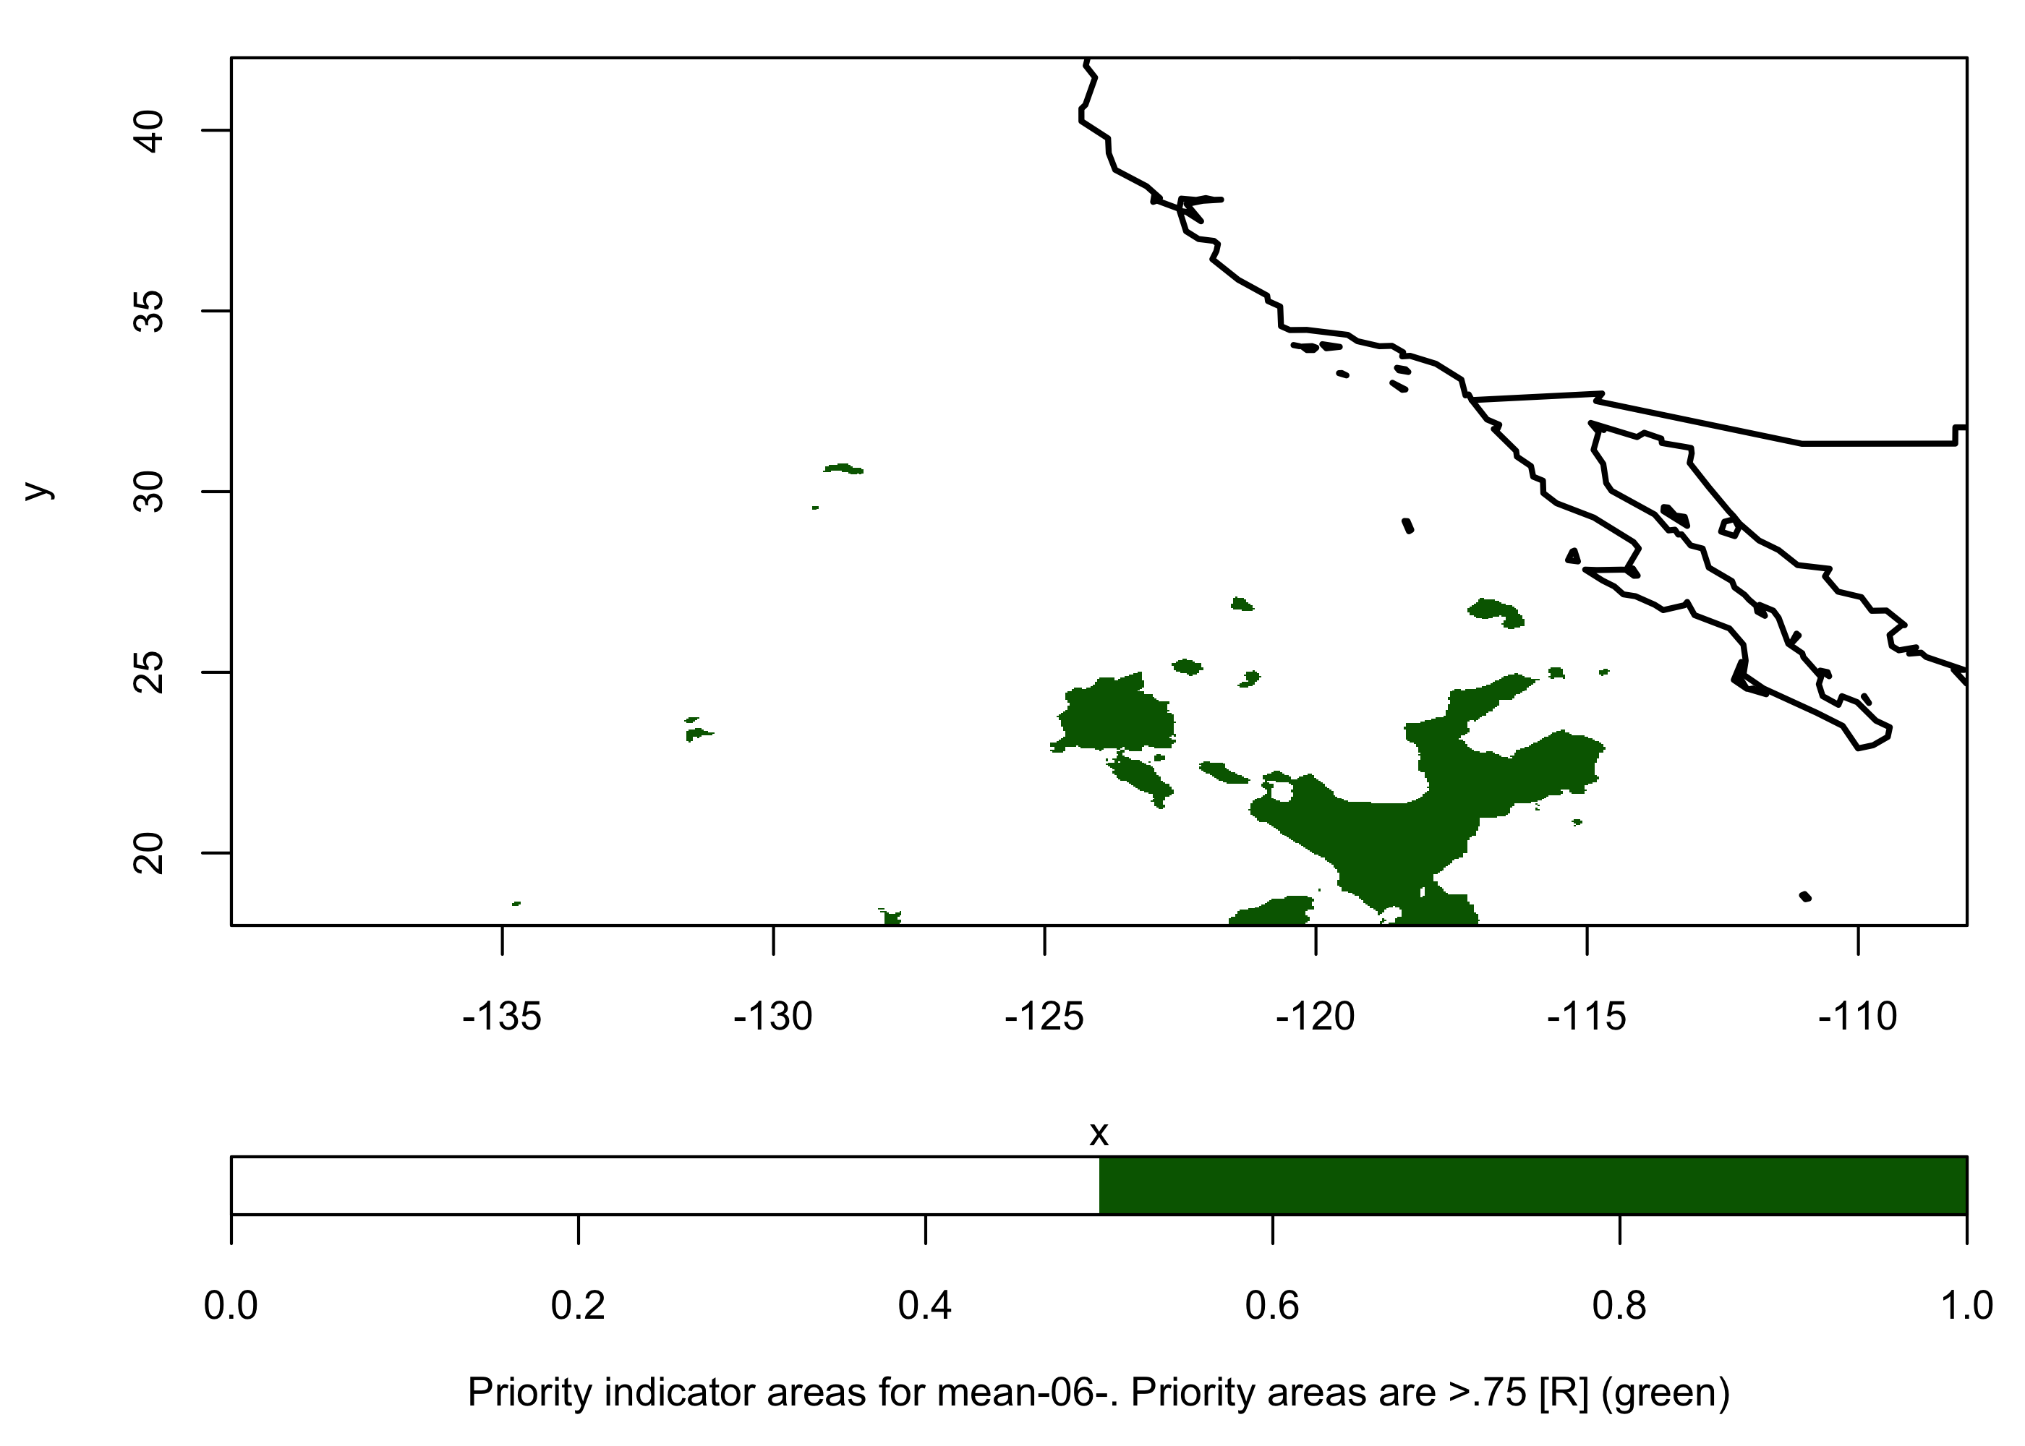
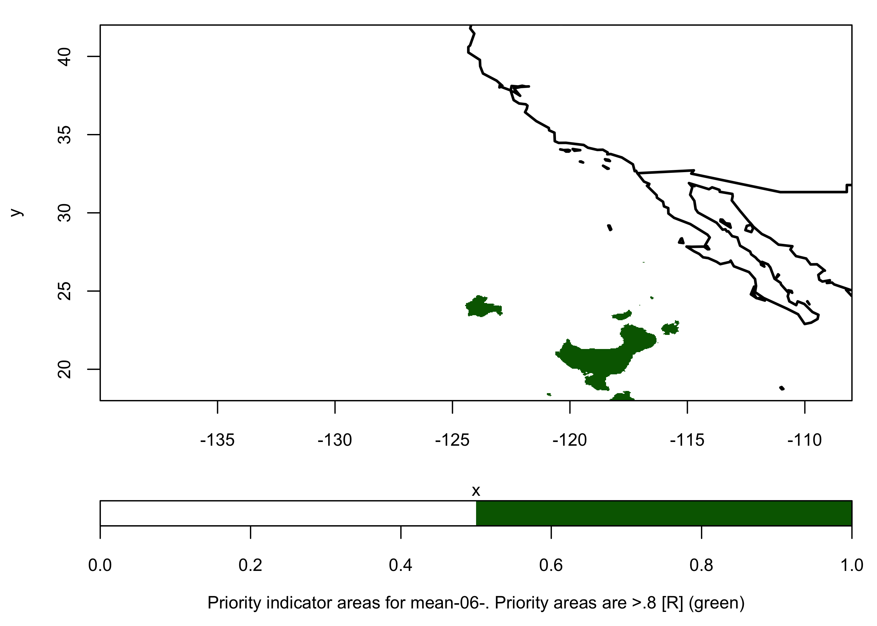
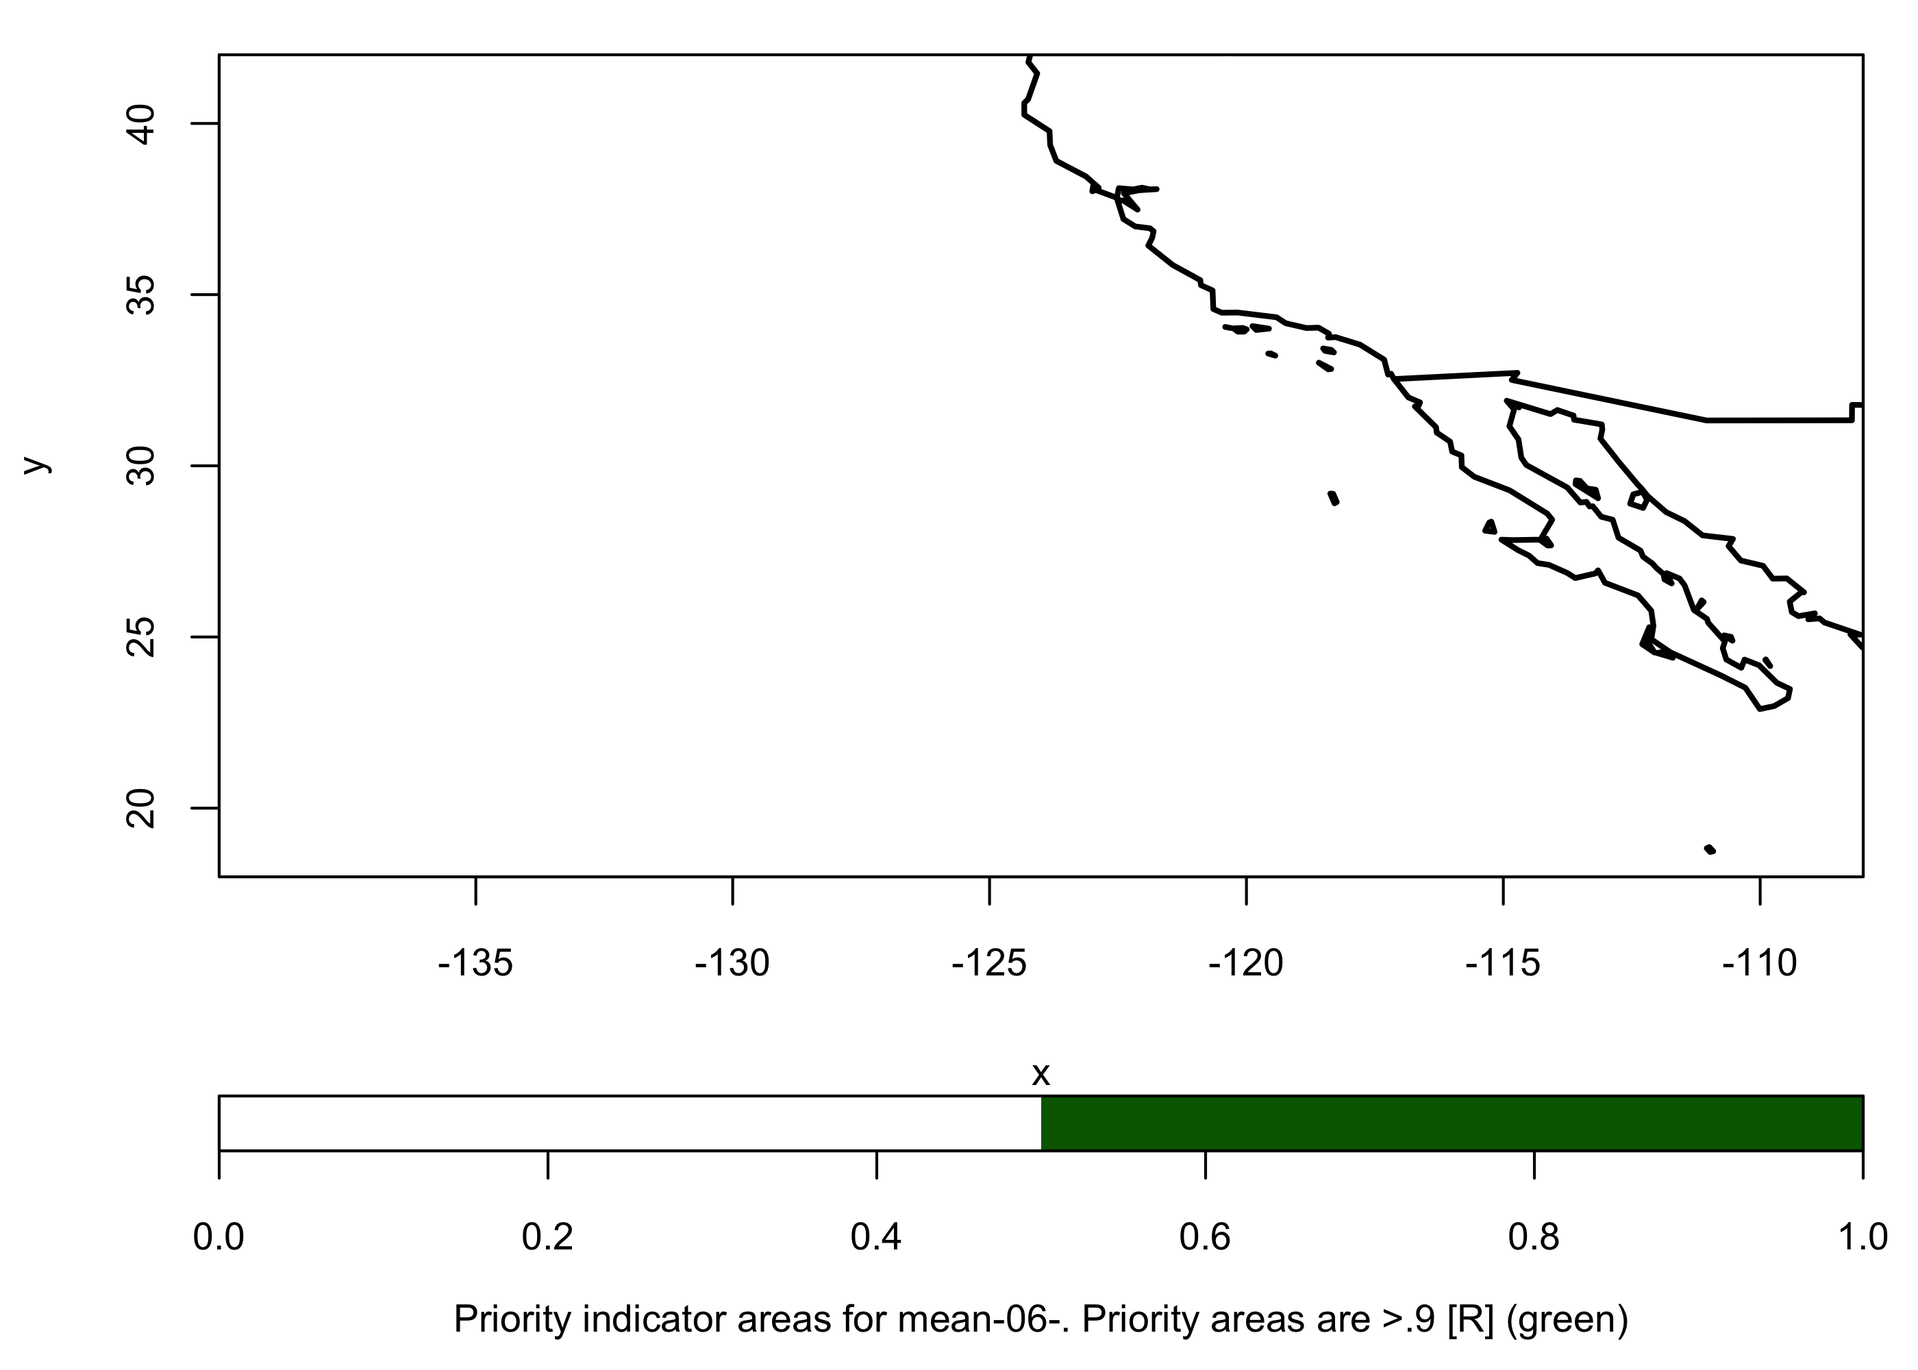
[R] no sightings removed
[R] no sightings zeroed
Common areas >.75
Common areas >.8
Common areas >.9
May
June

Slide 3
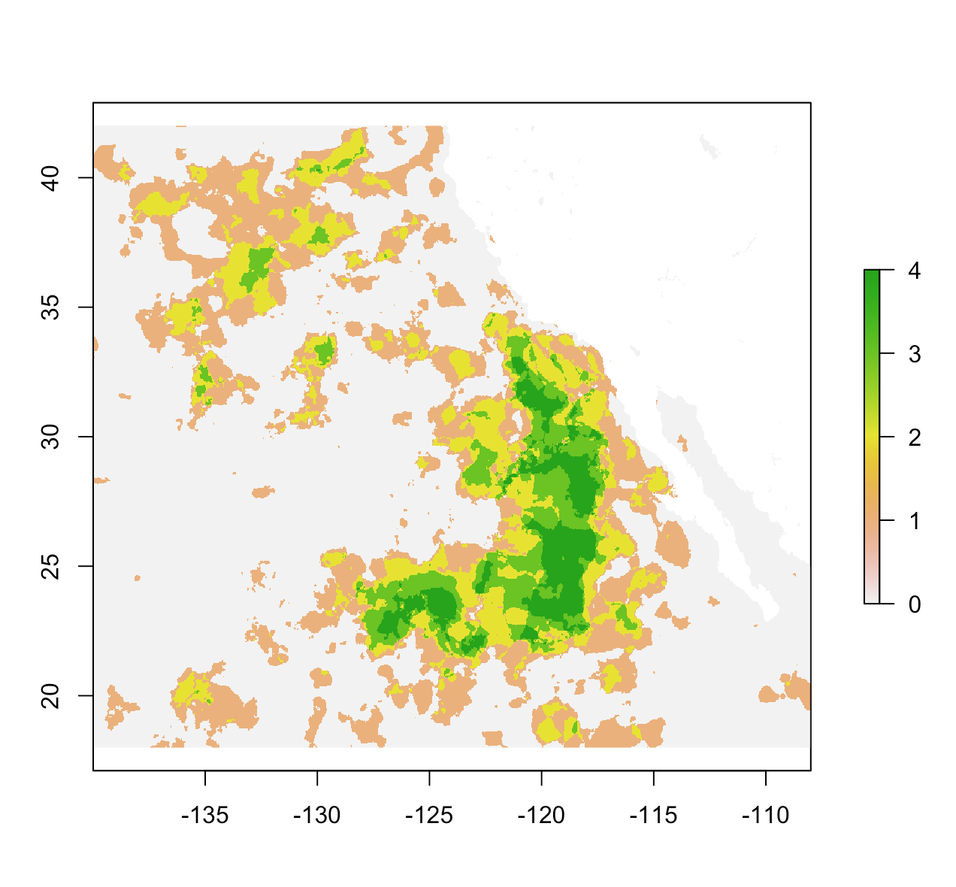
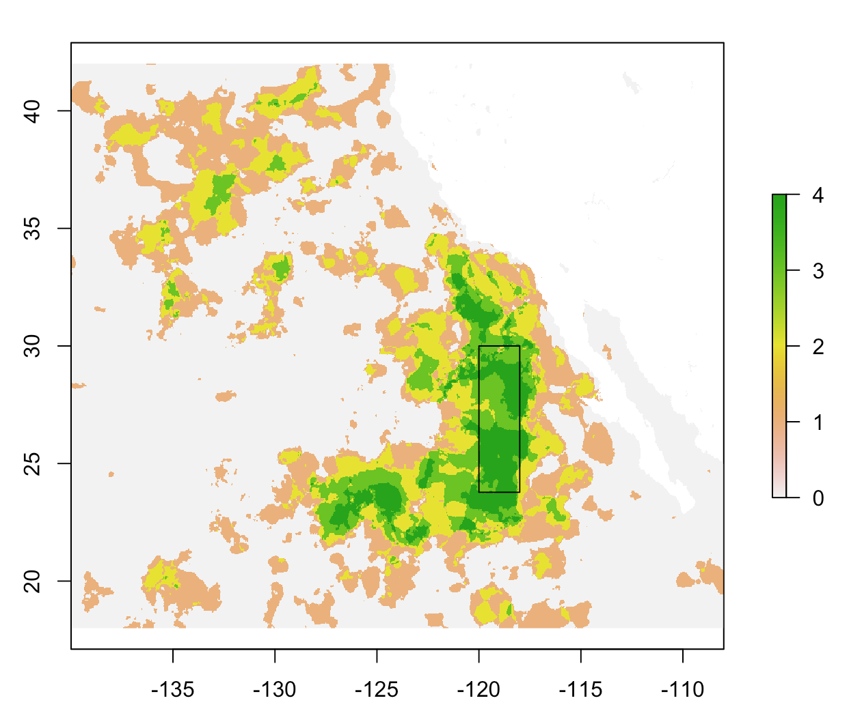
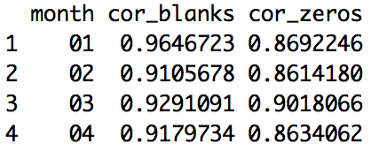
Creating an SST box
-Loggerhead closure comes into effect June 1st, ideally box would be based on conditions in Jan-May ahead of closure
-Jan – Apr have large concurrent patches of >.75 [R]
By summing the binary monthly plots from Jan - Apr, we can see the persistence of highly (>.75) pixels.
e.g. green pixels were >.75 in all 4 months (Jan, Feb, Mar, Apr); grey pixels were >.75 in zero months.
This SST box roughly covers pixels with the highest persistence in correlation across the four months.
When we look at the correlations between spatial averages of monthly SSTs within the box and # turtle sightings, we see R values are still quite high (even though we’ve moved from individual pixels to a box).

Slide 4
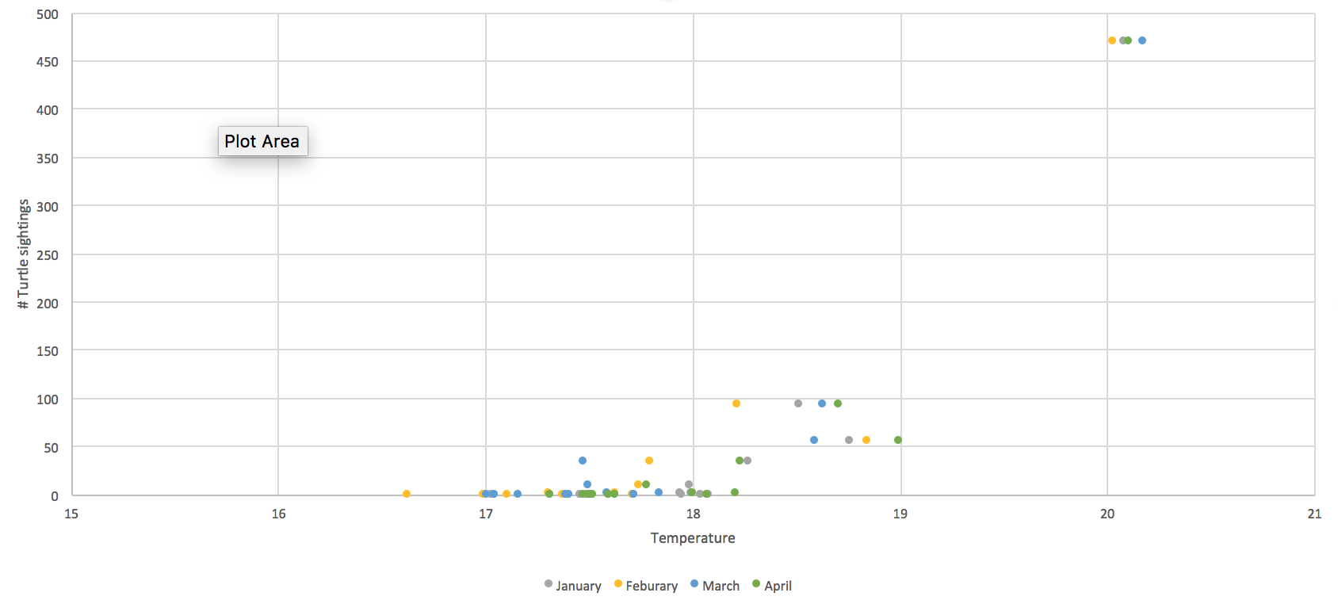
Creating a closure rule
Relationship between spatial averages of monthly SST within box and number of turtle sightings
All turtle sightings occurred when the average spatial temperature (Jan – April) within the SST box was > 17.5.
A potential rule might be, implement the loggerhead closure when average monthly temps are > 17.5 within the box for one or more months between January – April (inclusive). It seems important to not make the rule too targeted in time/space, given that we are working with gappy sighting data and a relatively coarse SST temporal resolution.

Slide 5
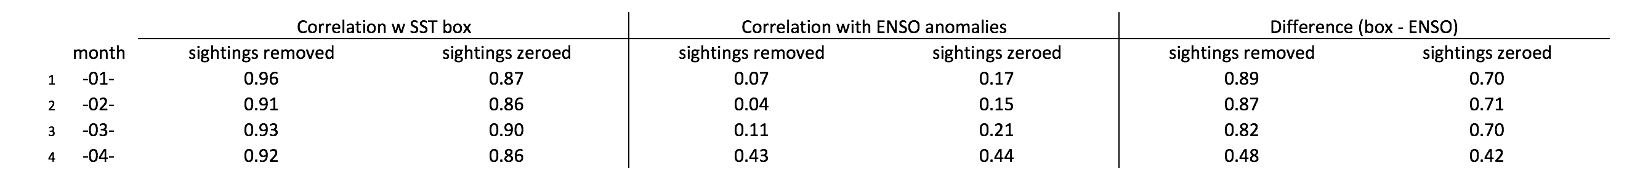
Comparison with ENSO index
Across Jan, Feb, Mar and April, the turtle sightings time-series is always more correlated with the SST box than the ENSO index.

